Slide 1
The Urinary System: Renal Function
18

Slide 2
Chapter Outline
18.1 Functions of the Urinary System
18.2 Anatomy of the Urinary System
18.3 Basic Renal Exchange Processes
18.4 Regional Specialization of the Renal Tubules
18.5 Excretion

Slide 3
18.1 Functions of the Urinary System
Regulate plasma ionic composition
Regulate plasma volume
Regulate plasma osmolarity
Regulate plasma pH
Remove metabolic waste products and foreign substances from plasma
Other functions
Secrete erythropoietin and renin
Activate vitamin D₃ to calcitriol
Gluconeogenesis

Slide 4
18.2 Anatomy of the Urinary System
Structures of the urinary system
Macroscopic anatomy of the kidney
Microscopic anatomy of the kidney
Blood supply to the kidney

Slide 5
Structures of the Urinary System
Kidneys: form urine
Ureters: transport urine from kidneys to bladder
Bladder: store urine
Urethra: excrete urine from bladder to outside of body

Slide 6
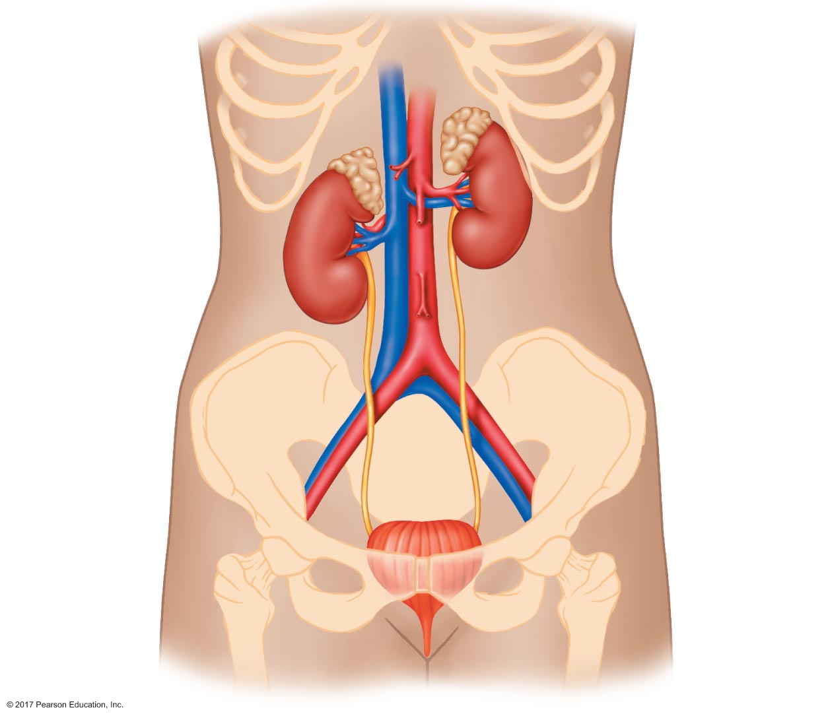
Figure 18.1 Structures of the urinary system.
Inferior vena cava
Abdominal aorta
Kidney
Adrenal gland
(part of the
endocrine
system)
Renal hilus
Renal artery
Renal vein
Ureter
Bladder
Neck of
bladder
Urethra

Slide 7
Macroscopic Anatomy of the Kidneys
Paired, bean shaped
Approximate size of fist; 115–170 grams
Retroperitoneal

Slide 8
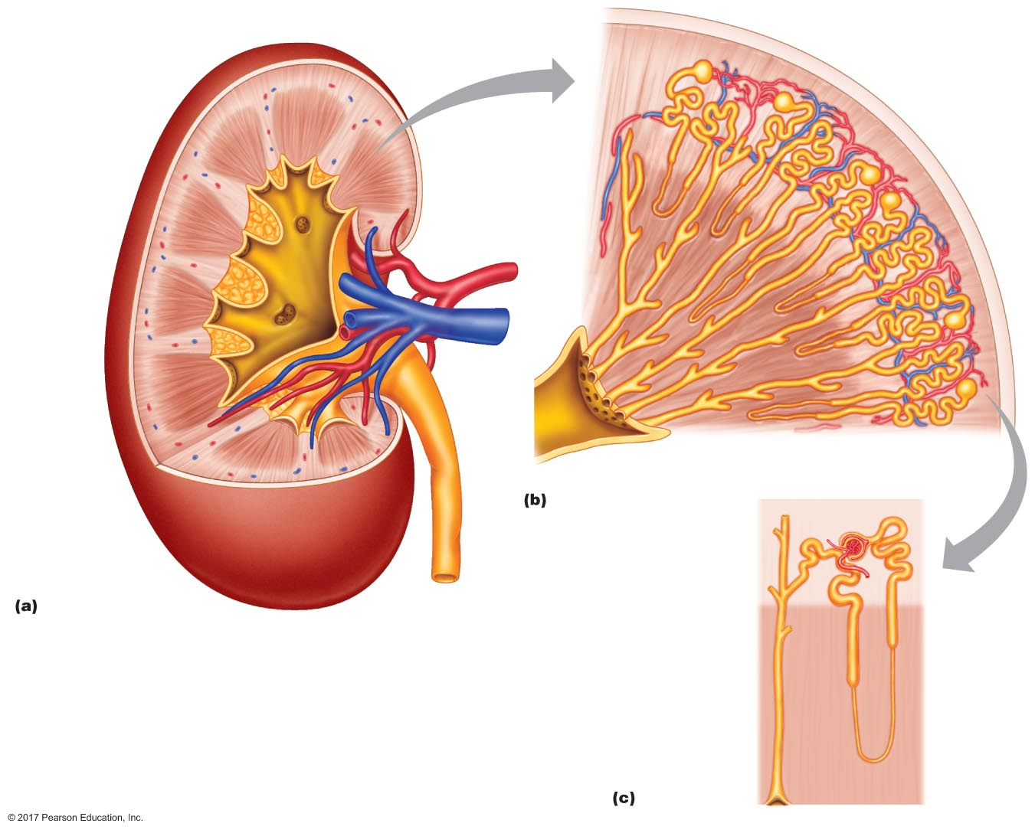
Figure 18.2 Anatomy of a kidney.
Renal cortex
Renal medulla
Renal pyramid
Renal papilla
Renal artery
Renal
pelvis
Minor calyx
Renal vein
Renal medulla
Renal cortex
Major calyx
Minor calyx
Bowman's capsule
Ureter
Blood vessels
Nephron
Collecting duct

Slide 9
Microscopic Anatomy of the Kidney
Nephron = functional unit
Renal corpuscle
Glomerulus = capillary network for filtration
Bowman's capsule
Receives the filtrate
Inflow to renal tubules

Slide 10
Microscopic Anatomy of the Kidney
Renal tubules
Proximal tubule
Proximal convoluted tubule
Proximal straight tubule
Loop of Henle
Descending limb
Thin ascending limb
Thick ascending limb
Distal convoluted tubule
Connecting tubule
Collecting duct

Slide 11
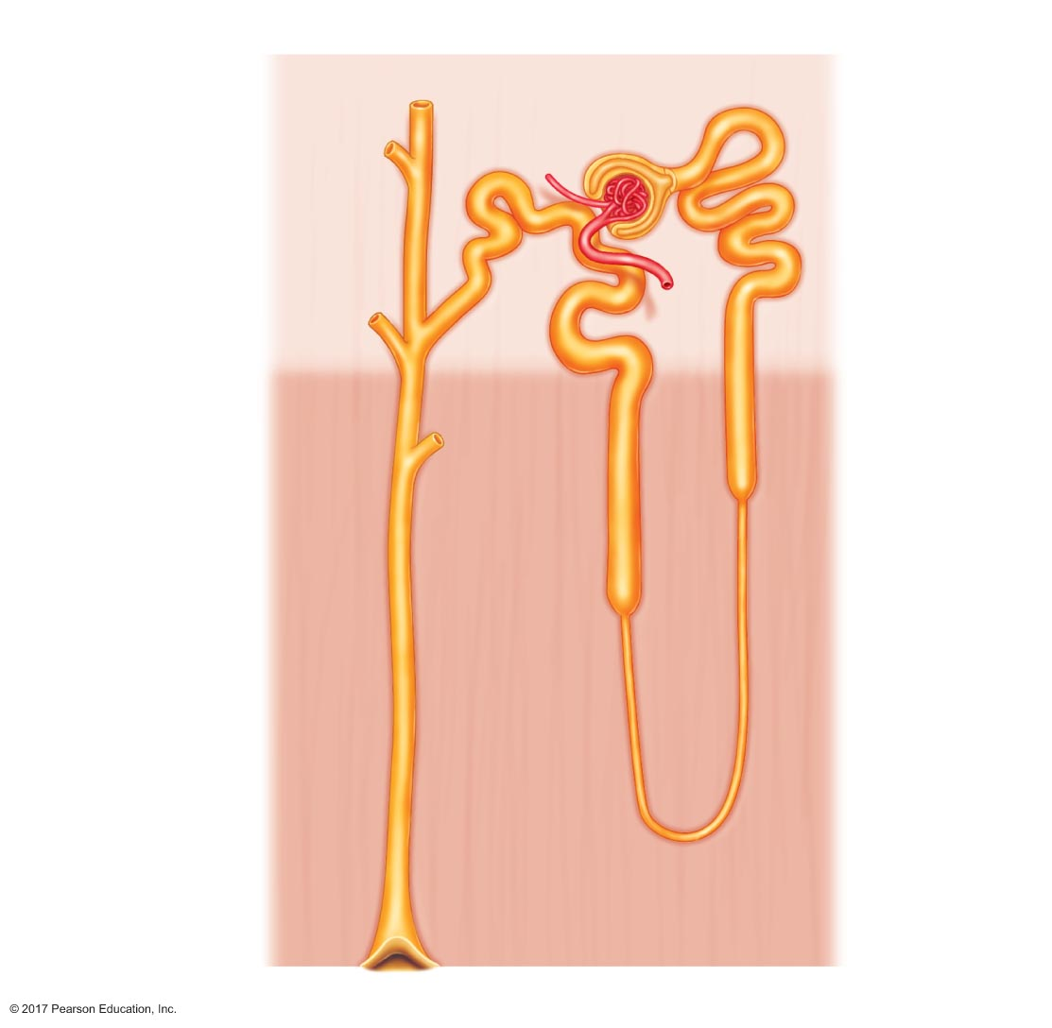
Figure 18.3 Anatomy of a nephron.
Renal corpuscle
Bowman's capsule
Glomerulus
Efferent arteriole
Afferent arteriole
Proximal
convoluted
tubule
Connecting tubule
Distal convoluted
tubule
Proximal tubule
Cortex
Medulla
Proximal
straight
tubule
Thick ascending limb
of loop of Henle
Collecting duct
Descending limb
of loop of Henle
Thin ascending limb
of loop of Henle
Minor calyx

Slide 12
Microscopic Anatomy of the Kidney
Cortical versus juxtamedullary nephrons
Cortical
Short loop of Henle
Most numerous, 80–85%
Juxtamedullary nephron
Long loop of Henle extends into medulla
Responsible for the medullary osmotic gradient
Both types produce urine

Slide 13
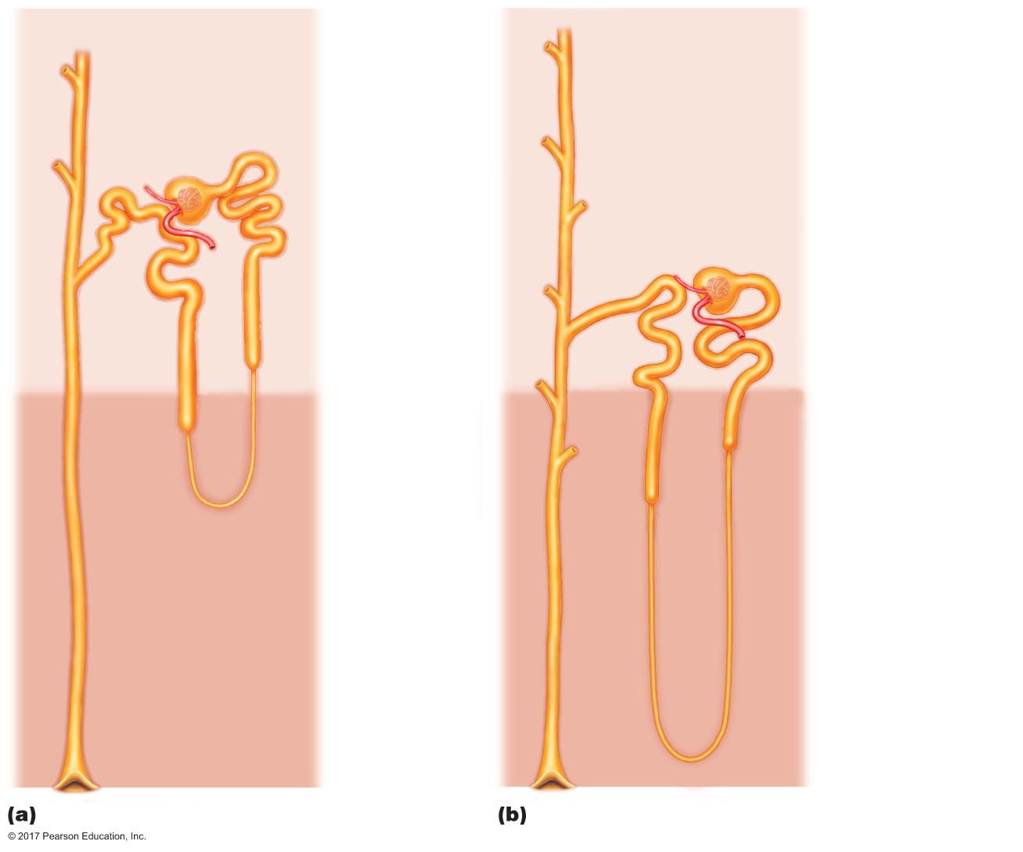
Figure 18.4 Locations of cortical and juxtamedullary nephrons.
Bowman's capsule
Renal
cortex
Bowman's capsule
Proximal
tubule
Proximal
tubule
Distal
tubule
Distal
tubule
Loop of
Henle
Collecting
duct
Renal
medulla
Loop of
Henle
Collecting
duct
Cortical nephron
Juxtamedullary nephron

Slide 14
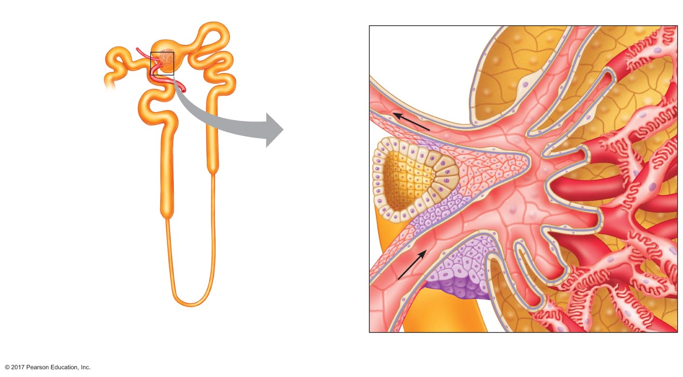
Figure 18.5 The juxtaglomerular apparatus.
Bowman's capsule
Juxtaglomerular
apparatus
Glomerular capillary
Efferent arteriole
Lumen of
Bowman's
capsule
Distal tubule
Proximal
tubule
Afferent arteriole
Efferent
arteriole
Distal
tubule
Macula
densa
Direction of
blood ﬂow
Loop of
Henle
Afferent
arteriole
Granular cells (juxtaglomerular cells)

Slide 15
Blood Supply
Renal arteries enter kidney at hilus
Receive 20% of cardiac output at rest
Account for less than 1% of body weight
Account for 16% of ATP usage by body
Function is to filter blood
Renal veins exit at hilus

Slide 16
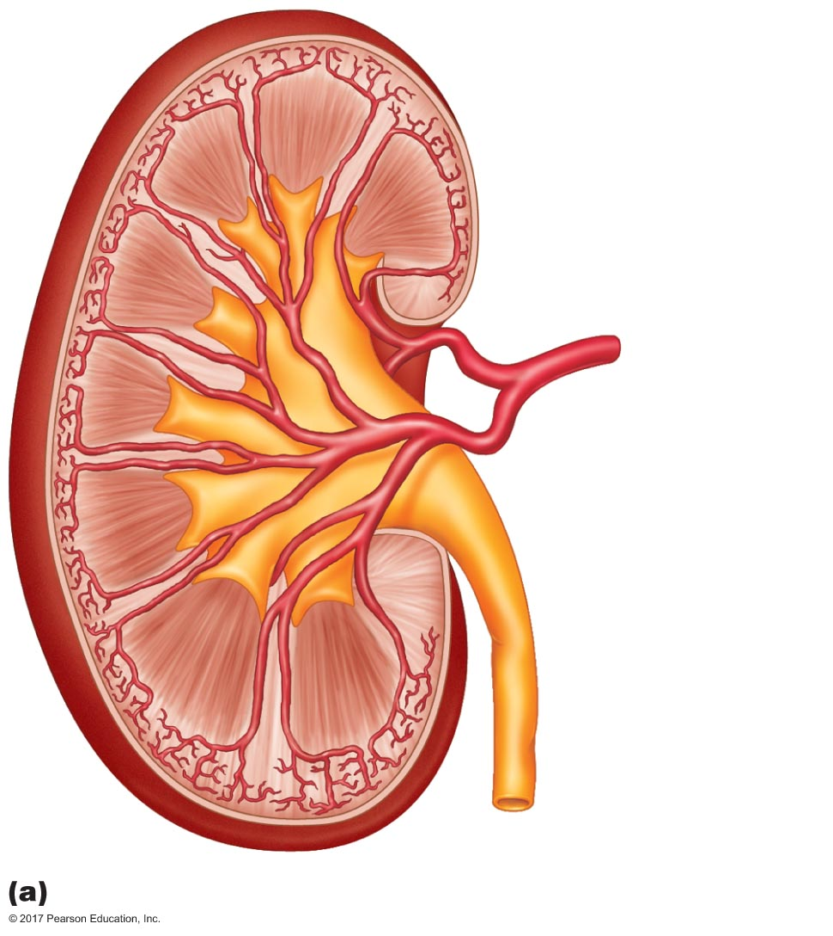
Figure 18.6a Blood supply to the kidneys.
Interlobular artery
Arcuate artery
Interlobar artery
Segmental artery
Renal artery

Slide 17
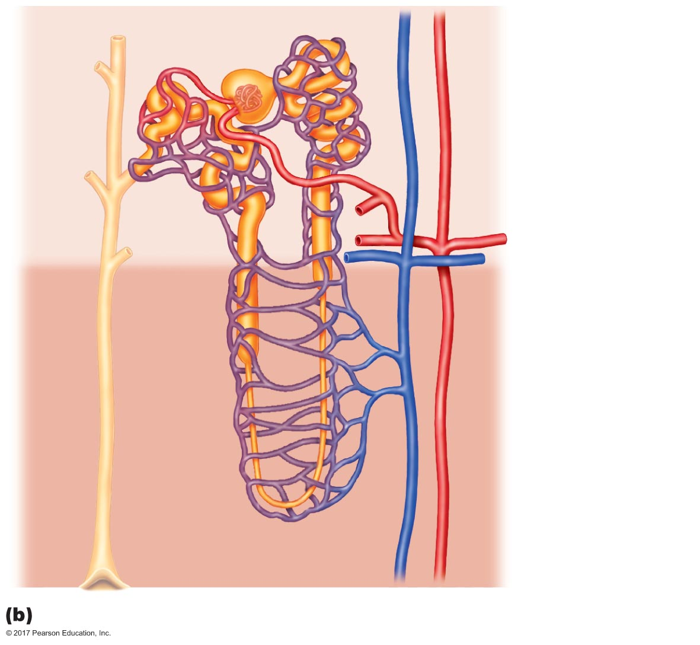
Figure 18.6b Blood supply to the kidneys.
Efferent arteriole
Glomerulus
Peritubular
capillaries
Afferent arteriole
Interlobular artery
Cortex
Arcuate artery
Medulla
Arcuate vein
Interlobular vein
Vasa
recta

Slide 18
18.3 Basic Renal Exchange Processes
Glomerular filtration: from glomerulus to Bowman's capsule
Reabsorption: from tubules to peritubular capillaries
Secretion: from peritubular capillaries to tubules
Excretion: from tubules out of body

Slide 19
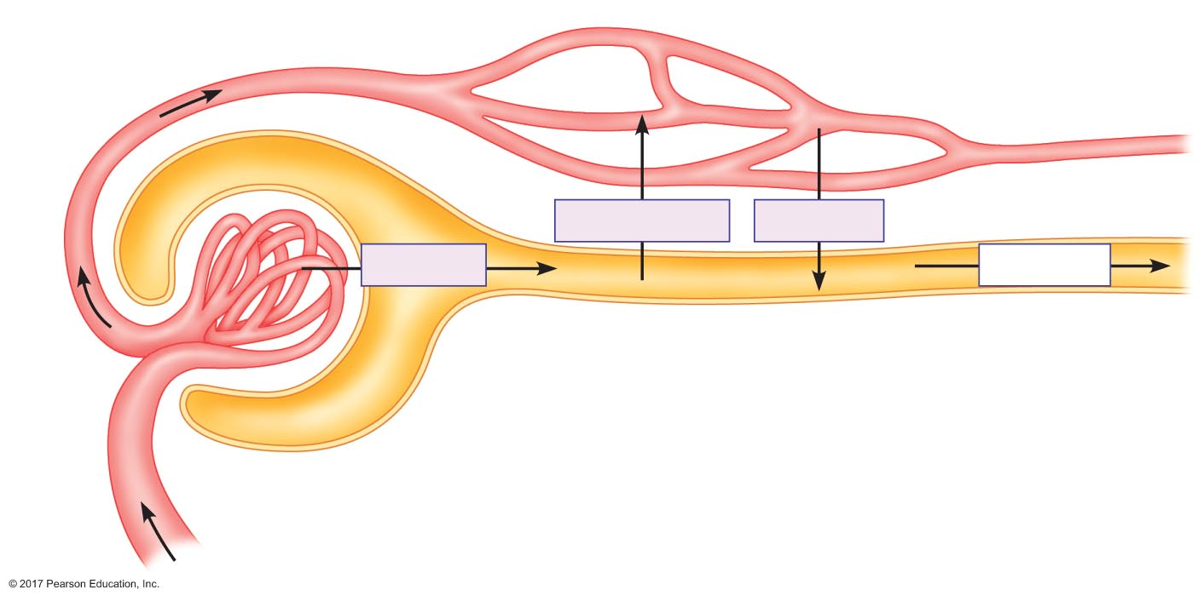
Figure 18.7 The three exchange processes in the renal tubules.
Direction of blood ﬂow
Peritubular
capillaries
Efferent
arteriole
Reabsorption
Secretion
Filtration
Excretion
Glomerulus
Afferent
arteriole
Bowman's capsule

Slide 20
Glomerular Filtration
Movement of protein-free plasma from glomerulus to Bowman's capsule
GFR = 125 mL/min or 180 L/day
Glomerular filtrate must cross three barriers to enter Bowman's capsule
Capillary endothelial layer
Surrounding epithelial layer
Basement membrane sandwiched between these two layers

Slide 21
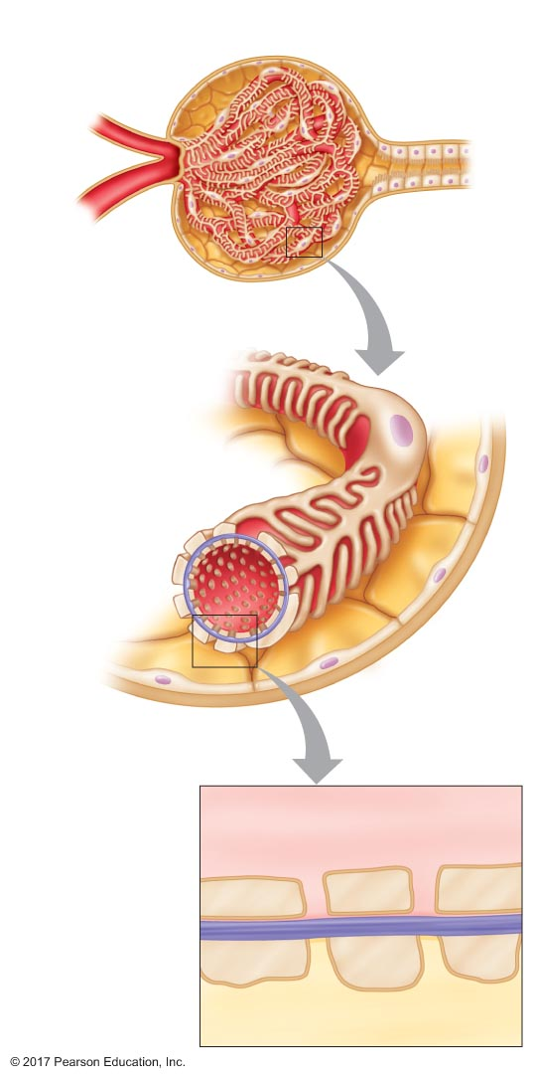
Figure 18.8 Anatomy of the renal corpuscle.
Bowman's capsule
Efferent arteriole
Proximal tubule
Afferent arteriole
Podocyte
Foot processes
Filtration slit
Lumen of
glomerular
capillary
Bowman's
space
Plasma in lumen
of capillary
Fenestration
Capillary
endothelial cell
Basement
membrane
Glomerular membrane
Epithelial cell
(podocyte)
Filtrate in
Bowman's space
Slit pore

Slide 22


Slide 23
Glomerular Filtration
Starling forces
Glomerular capillary hydrostatic pressure
Bowman's capsule oncotic pressure
Bowman's capsule hydrostatic pressure
Glomerular oncotic pressure

Slide 24
Glomerular Filtration
Starling forces favoring filtration
Glomerular capillary hydrostatic pressure
60 mm Hg
High due to resistance of efferent arteriole
Bowman's capsule oncotic pressure
0 mm Hg
Low due to lack of protein in filtrate

Slide 25
Glomerular Filtration
Starling forces opposing filtration
Bowman's capsule hydrostatic pressure
15 mm Hg
Relatively high (compared to systemic capillaries) due to large volume of filtrate in closed space
Glomerular oncotic pressure
29 mm Hg
Higher than in systemic capillaries due to plasma proteins in smaller volume of plasma

Slide 26
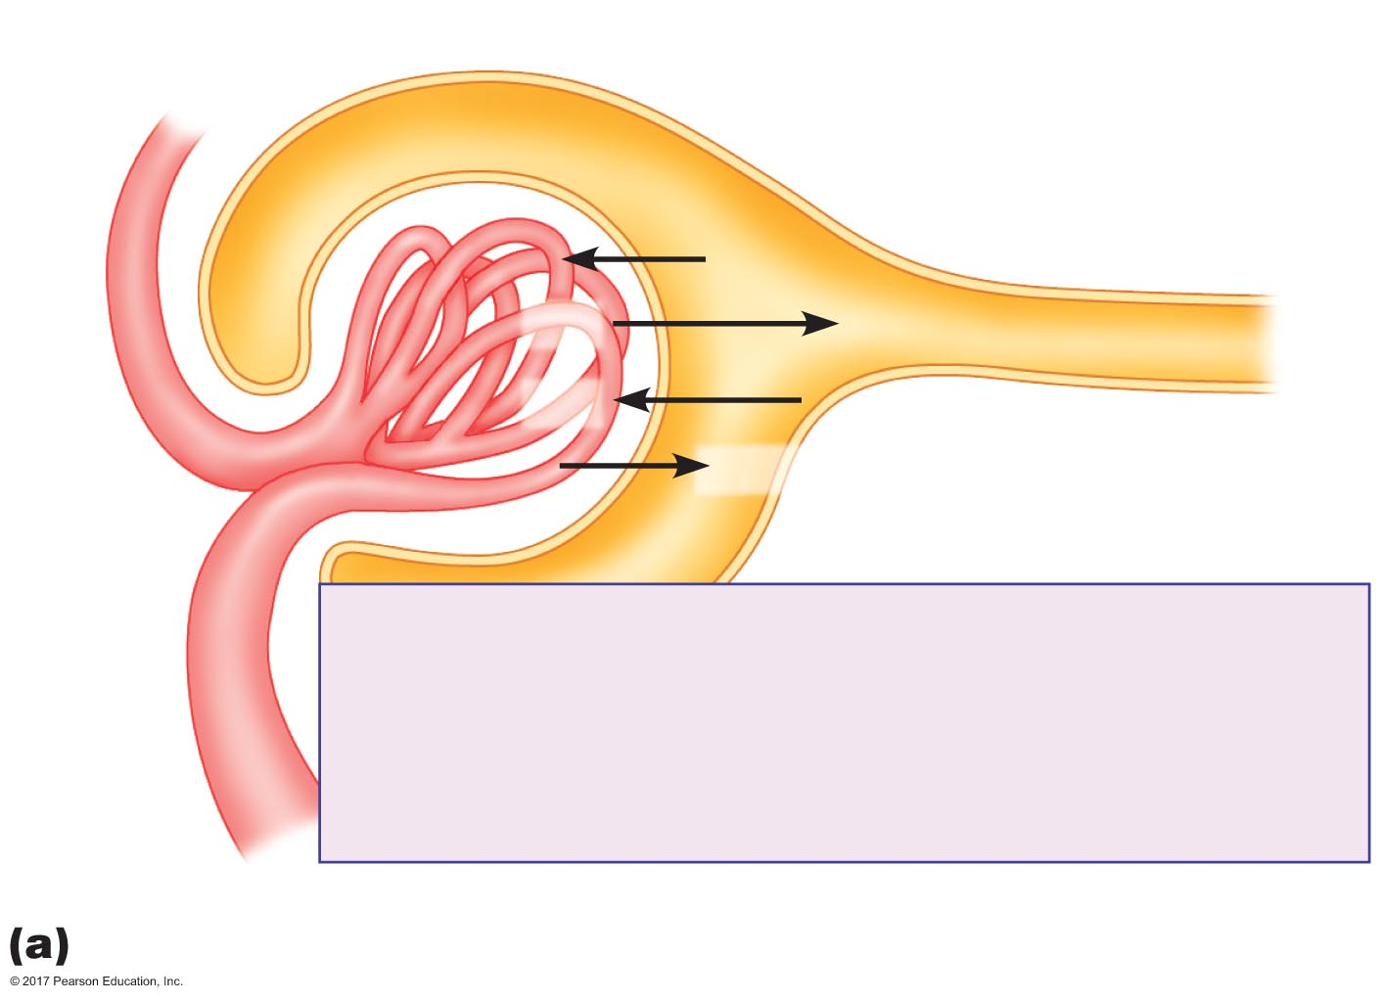
Figure 18.9a Glomerular filtration.
Efferent
arteriole
P_{BC}
P_{GC}
π_{GC}
π_{BC}
Glomerular ﬁltration pressure =
(P_{GC} + π_{BC}) – (P_{BC} + π_{GC}) =
(60 mm Hg + 0 mm Hg) – (15 mm Hg + 29 mm Hg)
= 16 mm Hg
Afferent
arteriole
Glomerular ﬁltration pressure

Slide 27
Glomerular Filtration
Glomerular filtration rate (GFR)
Filtration pressure = (P_{GC} + π_{BC}) – (P_{BC} + π_{GC}) = (60 + 0) – (15 + 29) = 16 mm Hg
Renal plasma flow = 625 mL/min
GFR = 125 mL/min = 180 L/day
Compared to systemic capillaries
Filtration pressure = 2 mm Hg
Filtration rate = 3 L/day

Slide 28
Glomerular Filtration
Filtration fraction
Filtration faction = GFR/renal plasma flow
625 mL plasma enters kidneys per minute
125 mL filtered into Bowman's capsule
125/625 = filtration fraction = 20%

Slide 29
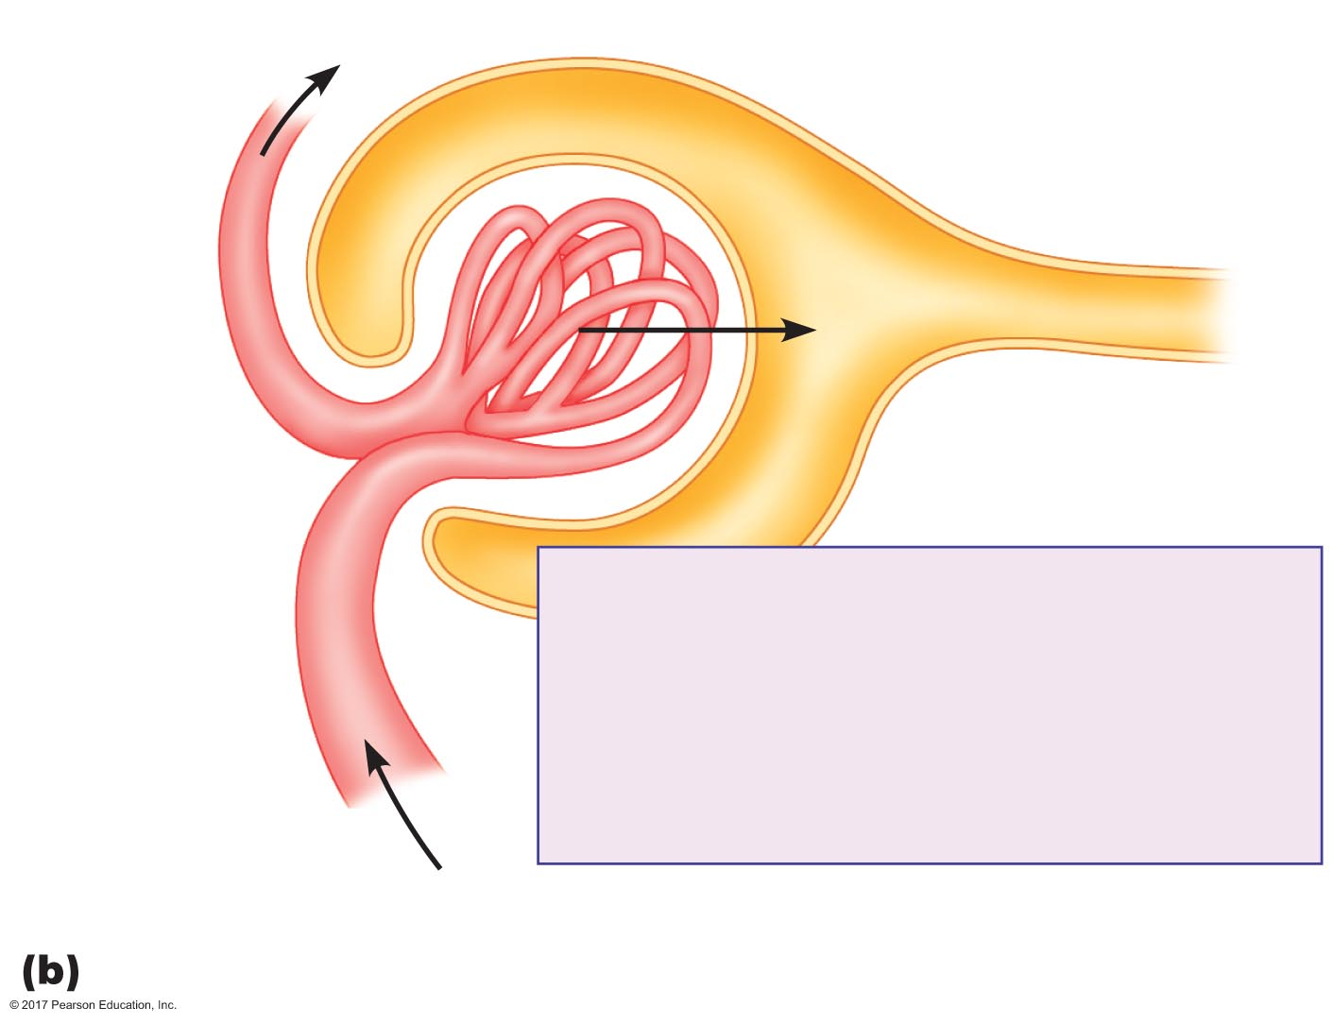
Figure 18.9b Glomerular filtration.
500 mL/min plasma
Efferent
arteriole
125 mL/min ﬁltrate
Plasma ﬂow rate = 625 mL/min
Glomerular ﬁltration rate = 125 mL/min
Filtration fraction =
Afferent
arteriole
125 mL/min
625 mL/min
= 0.20 = 20%
625 mL/min plasma
Glomerular ﬁltration rate and ﬁltration fraction

Slide 30
Glomerular Filtration
Filtered load = GFR × P_{x}
Small molecules that are filtered without impedance are freely filterable
Quantity filtered = filtered load
Depends on plasma concentration of solute and GFR
Filtered load of glucose
GFR = 125 mL/min
Plasma [glucose] =100 mg/dL = 1 mg/mL
Filtered load of glucose = (125 mL/min) × (1 mg/mL) = 125 mg/min

Slide 31
Regulation of GFR
180 liters fluid filtered/day
Only 1.5 liters urine is excreted/day (<1%)
>99% of filtered fluid is reabsorbed
Small increase in GFR → large increase in volume of fluid filtered and excreted
GFR is highly regulated

Slide 32
Glomerular Filtration
Intrinsic regulation of GFR
Myogenic regulation
Smooth muscle in wall of afferent arteriole
Contracts in response to stretch
Tubuloglomerular feedback
Macula densa cells secrete paracrine factors in response to an increase in flow of fluid past them
Smooth muscles of arterioles contract in response to these paracrines

Slide 33
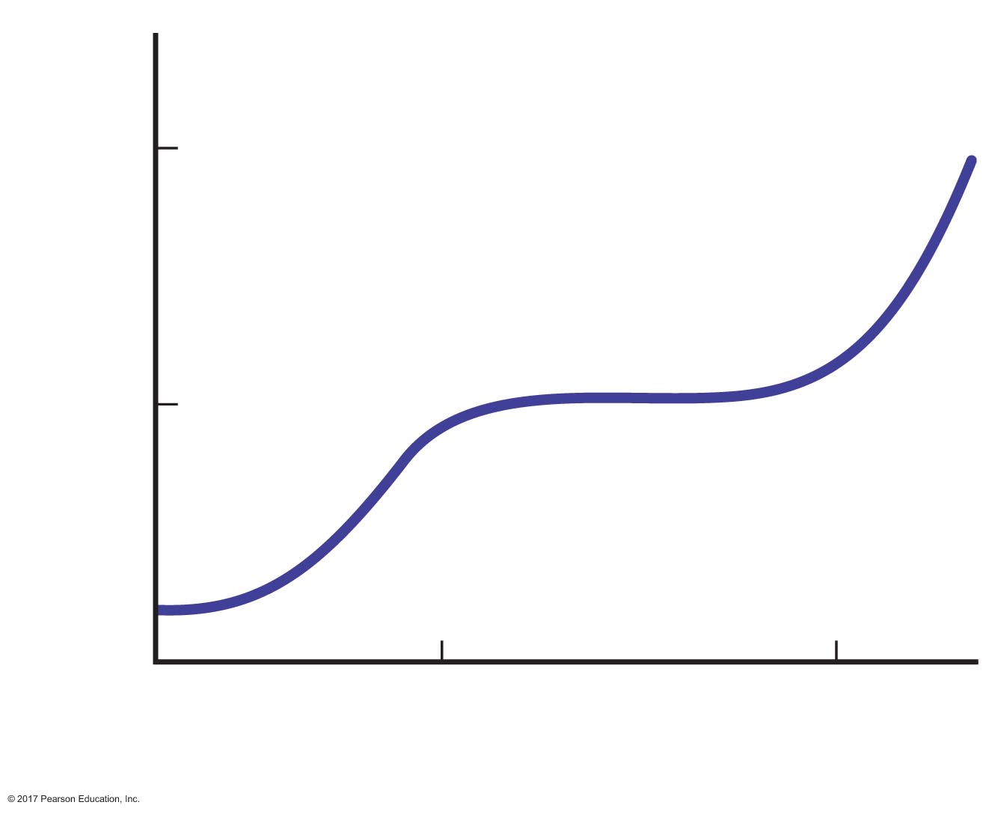
Figure 18.10 Effect of mean arterial pressure on glomerular filtration rate.
250
Glomerular ﬁltration rate (mL/min)
125
0
80
180
Mean arterial pressure (mm Hg)

Slide 34
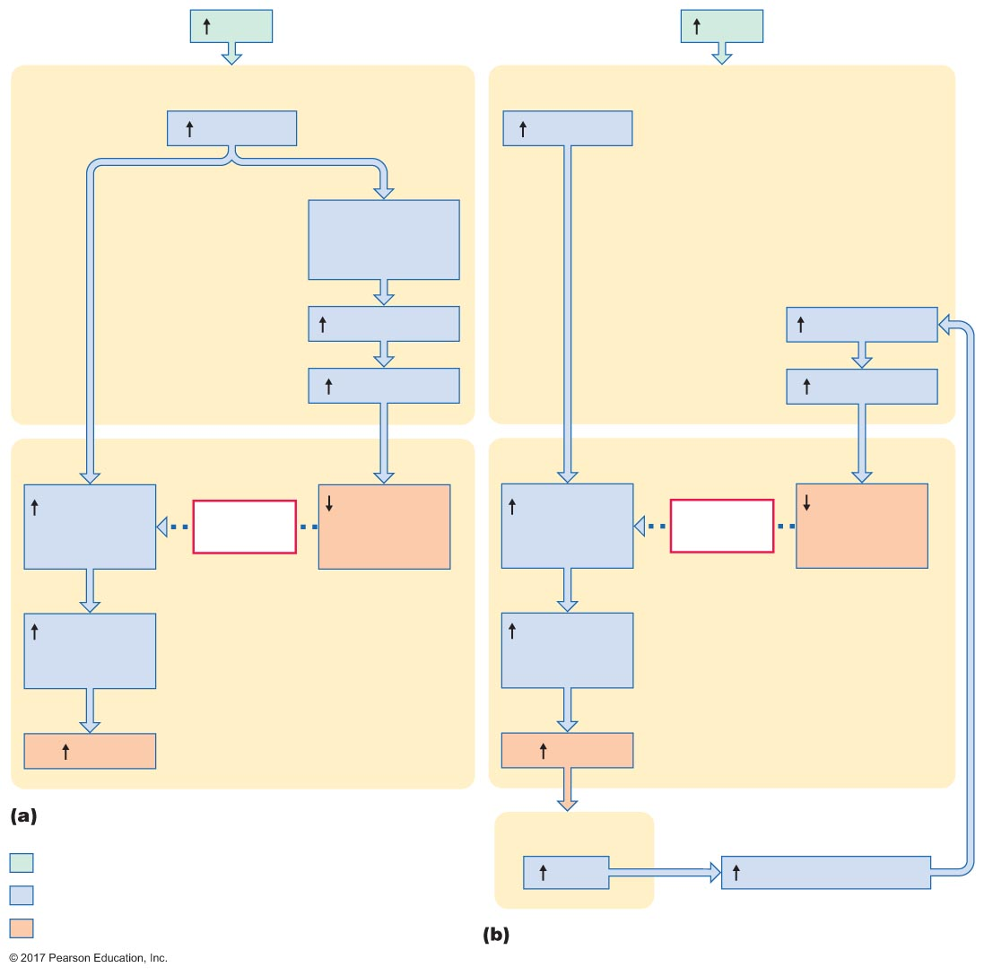
Figure 18.11 Intrinsic controls of glomerular filtration rate.
MAP
MAP
Afferent arteriole
Afferent arteriole
Pressure
Pressure
Stretch of
arteriolar
smooth muscle
Constriction
Constriction
Resistance
Resistance
Glomerulus
Glomerulus
Glomerular
capillary
pressure
Negative
feedback
Glomerular
capillary
pressure
Glomerular
capillary
pressure
Negative
feedback
Glomerular
capillary
pressure
Glomerular
ﬁltration
pressure
Glomerular
ﬁltration
pressure
GFR
GFR
Myogenic regulation
Macula densa
Initial stimulus
Flow
Paracrine secretion
Physiological response
Result
Tubuloglomerular feedback

Slide 35
Glomerular Filtration
Extrinsic control of GFR
Decreases in BP can decrease GFR
Directly (decrease in filtration pressure)
Indirectly through extrinsic controls

Slide 36
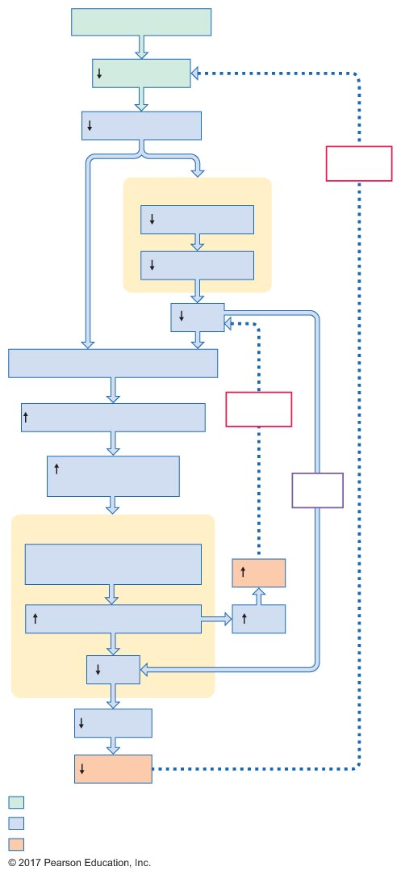
Figure 18.12 Extrinsic control of GFR and renal vascular resistance during fluid loss due to hemorrhage or sweating.
Slide 1
Hemorrhage, sweating
Blood volume
Venous pressure
Negative
feedback
Heart
Venous return
Cardiac output
MAP
Baroreceptors detect and respond
Sympathetic nervous activity
Negative
feedback
Renal sympathetic
nervous activity
Direct
effect
Kidneys
Vasoconstriction of afferent
and efferent arterioles
MAP
Renal vascular resistance
TPR
GFR
Urine ﬂow
Fluid loss
Initial stimulus
Physiological response
Result

Slide 37
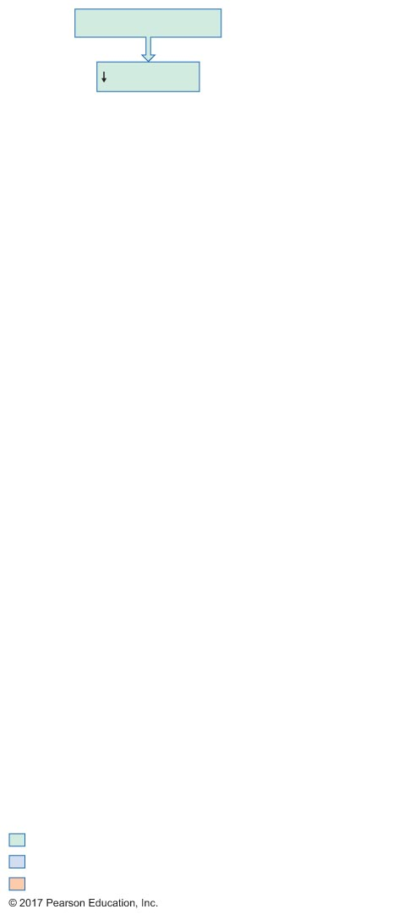
Figure 18.12 Extrinsic control of GFR and renal vascular resistance during fluid loss due to hemorrhage or sweating.
Slide 2
Hemorrhage, sweating
Blood volume
Initial stimulus
Physiological response
Result

Slide 38
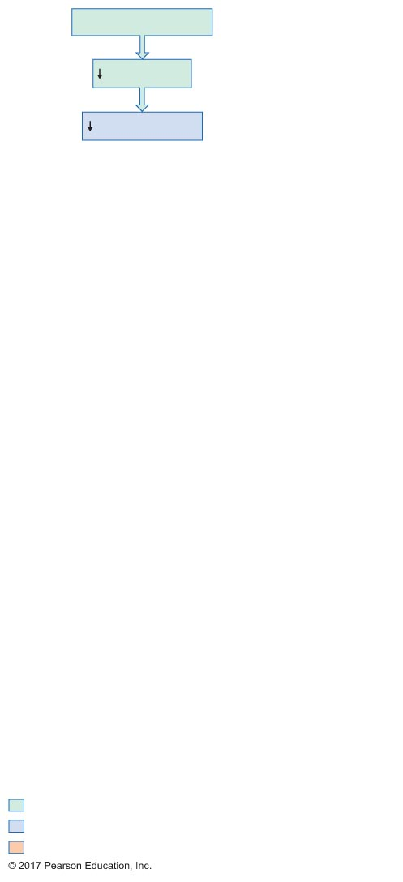
Figure 18.12 Extrinsic control of GFR and renal vascular resistance during fluid loss due to hemorrhage or sweating.
Slide 3
Hemorrhage, sweating
Blood volume
Venous pressure
Initial stimulus
Physiological response
Result

Slide 39
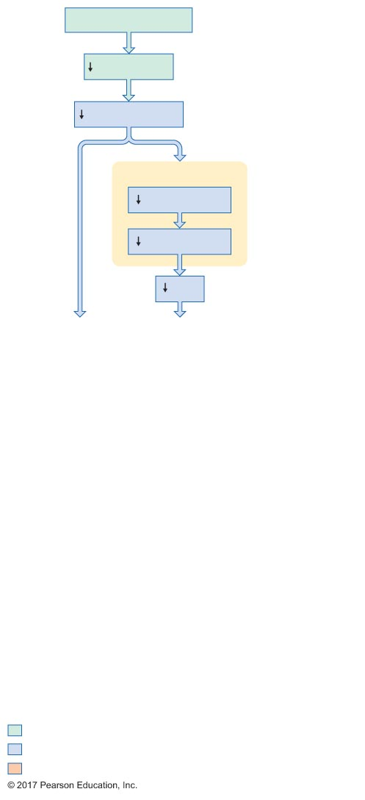
Figure 18.12 Extrinsic control of GFR and renal vascular resistance during fluid loss due to hemorrhage or sweating.
Slide 4
Hemorrhage, sweating
Blood volume
Venous pressure
Heart
Venous return
Cardiac output
MAP
Initial stimulus
Physiological response
Result

Slide 40
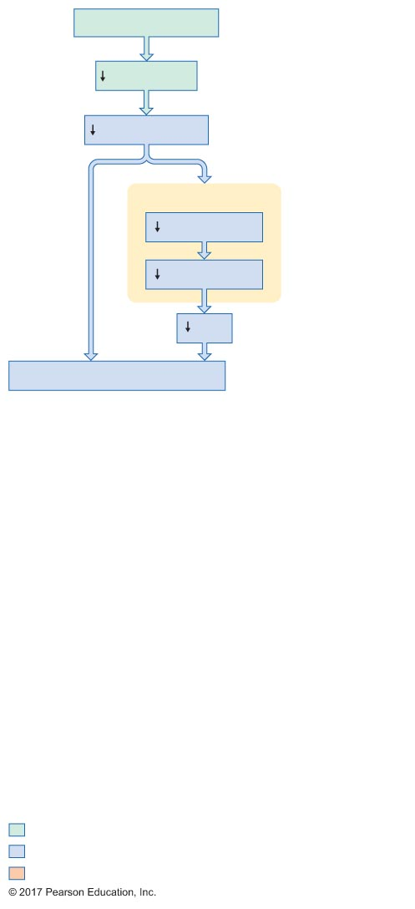
Figure 18.12 Extrinsic control of GFR and renal vascular resistance during fluid loss due to hemorrhage or sweating.
Slide 5
Hemorrhage, sweating
Blood volume
Venous pressure
Heart
Venous return
Cardiac output
MAP
Baroreceptors detect and respond
Initial stimulus
Physiological response
Result

Slide 41
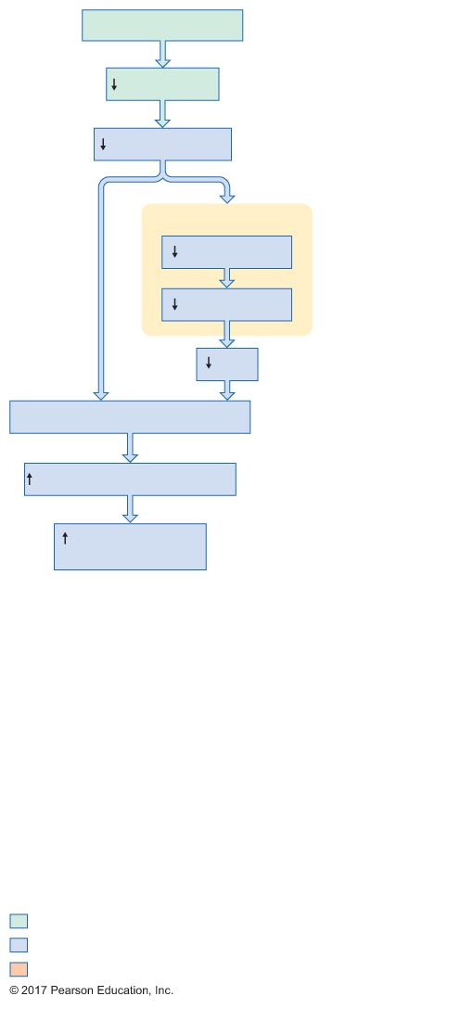
Figure 18.12 Extrinsic control of GFR and renal vascular resistance during fluid loss due to hemorrhage or sweating.
Slide 6
Hemorrhage, sweating
Blood volume
Venous pressure
Heart
Venous return
Cardiac output
MAP
Baroreceptors detect and respond
Sympathetic nervous activity
Renal sympathetic
nervous activity
Initial stimulus
Physiological response
Result

Slide 42
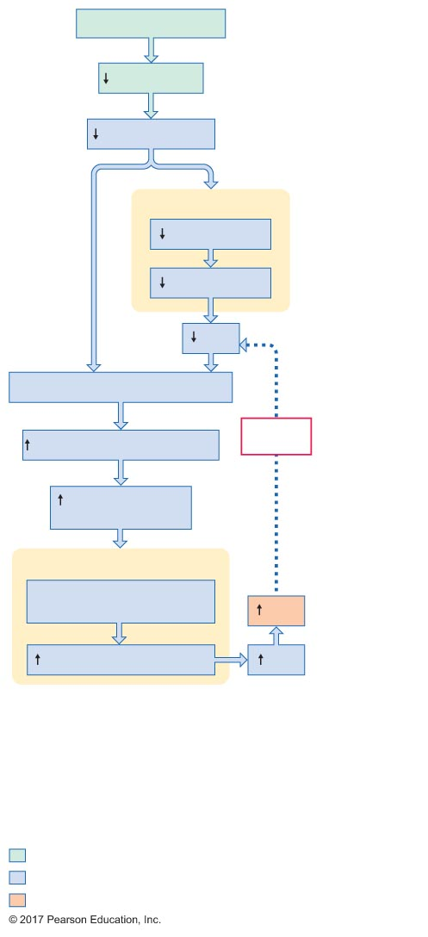
Figure 18.12 Extrinsic control of GFR and renal vascular resistance during fluid loss due to hemorrhage or sweating.
Slide 7
Hemorrhage, sweating
Blood volume
Venous pressure
Heart
Venous return
Cardiac output
MAP
Baroreceptors detect and respond
Sympathetic nervous activity
Negative
feedback
Renal sympathetic
nervous activity
Kidneys
Vasoconstriction of afferent
and efferent arterioles
MAP
Renal vascular resistance
TPR
Initial stimulus
Physiological response
Result

Slide 43
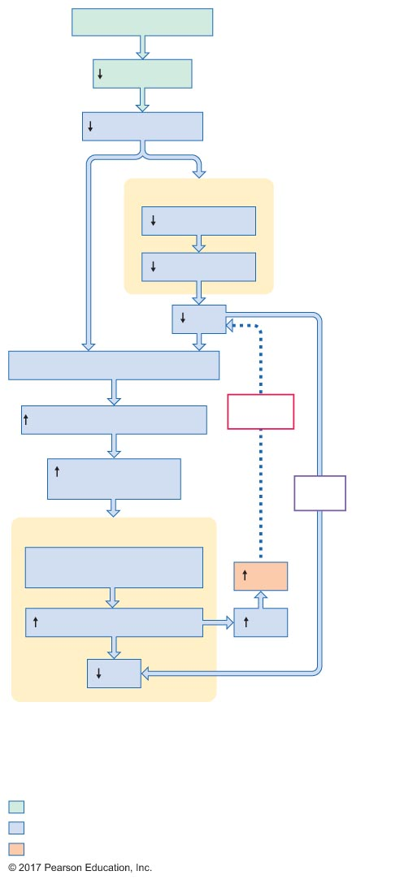
Figure 18.12 Extrinsic control of GFR and renal vascular resistance during fluid loss due to hemorrhage or sweating.
Slide 8
Hemorrhage, sweating
Blood volume
Venous pressure
Heart
Venous return
Cardiac output
MAP
Baroreceptors detect and respond
Sympathetic nervous activity
Negative
feedback
Renal sympathetic
nervous activity
Direct
effect
Kidneys
Vasoconstriction of afferent
and efferent arterioles
MAP
Renal vascular resistance
TPR
GFR
Initial stimulus
Physiological response
Result

Slide 44
Figure 18.12 Extrinsic control of GFR and renal vascular resistance during fluid loss due to hemorrhage or sweating.
Slide 9
Hemorrhage, sweating
Blood volume
Venous pressure
Negative
feedback
Heart
Venous return
Cardiac output
MAP
Baroreceptors detect and respond
Sympathetic nervous activity
Negative
feedback
Renal sympathetic
nervous activity
Direct
effect
Kidneys
Vasoconstriction of afferent
and efferent arterioles
MAP
Renal vascular resistance
TPR
GFR
Urine ﬂow
Fluid loss
Initial stimulus
Physiological response
Result

Slide 45
Reabsorption
Movement from tubules into peritubular capillaries (returned to blood)
Most occurs in proximal tubules
Most is not regulated

Slide 46
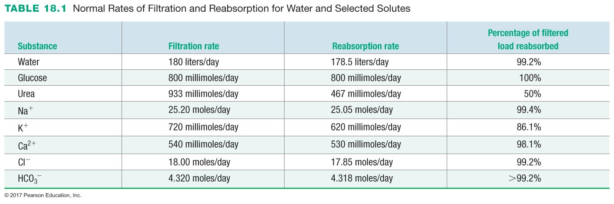

Slide 47
Reabsorption
Solute reabsorption
Most occurs in proximal convoluted tubules
Some occurs in distal convoluted tubules
Barrier for reabsorption
Epithelial cells of renal tubules
Endothelial cells of capillaries (minimal)

Slide 48
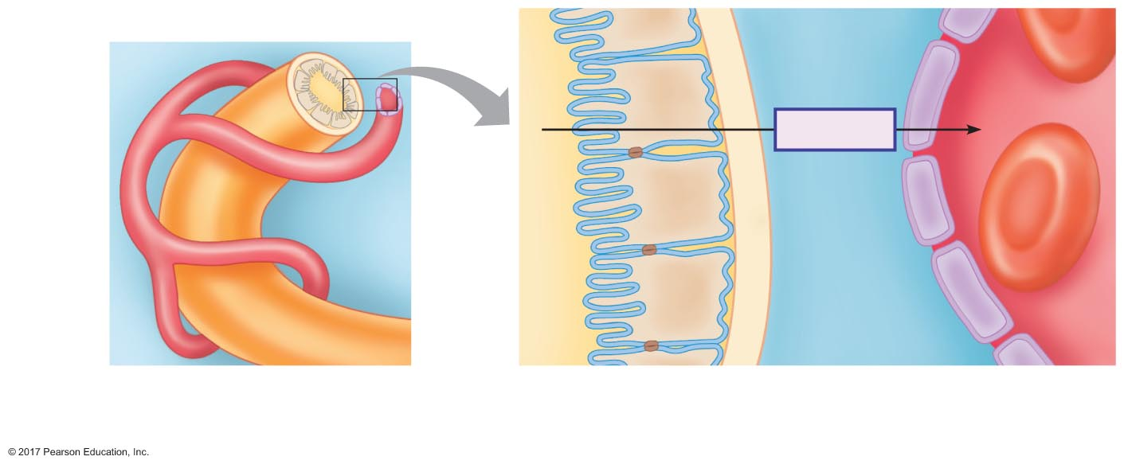
Figure 18.13 The barriers to reabsorption.
Lumen
Microvilli
Peritubular
space
Peritubular
capillary
Reabsorption
Apical
membrane
Renal
tubule
Tight
junction
Lumen
Peritubular space
Plasma
Tubule
epithelial
cell
Basolateral
membrane
Basement
membrane
Capillary
endothelial
cell

Slide 49
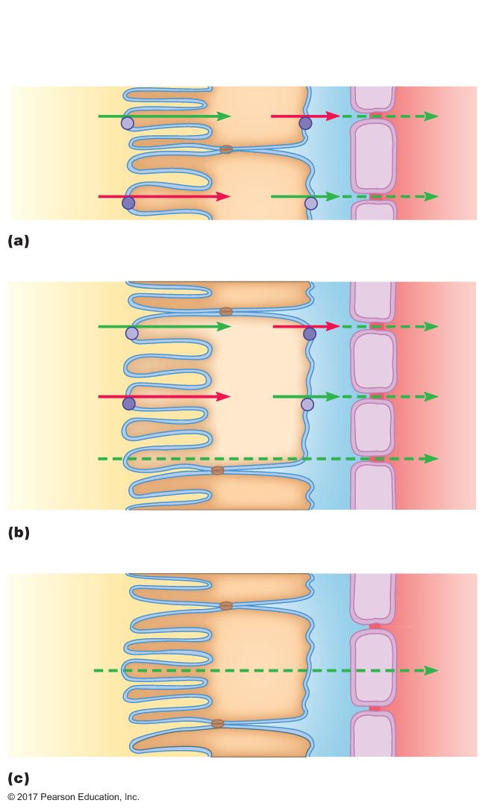
Figure 18.14 Mechanisms of solute and water reabsorption.
Peritubular ﬂuid
Apical
membrane
Tubule
epithelial cell
Basolateral
membrane
Capillary
endothelial cell
Y
Y
X
X
Active solute reabsorption
Solute Y
Solute X
H₂O
Water reabsorption (passive)
High
[Z]
Z
Low
[Z]
Tubular ﬂuid
Plasma
Passive solute reabsorption via diffusion

Slide 50
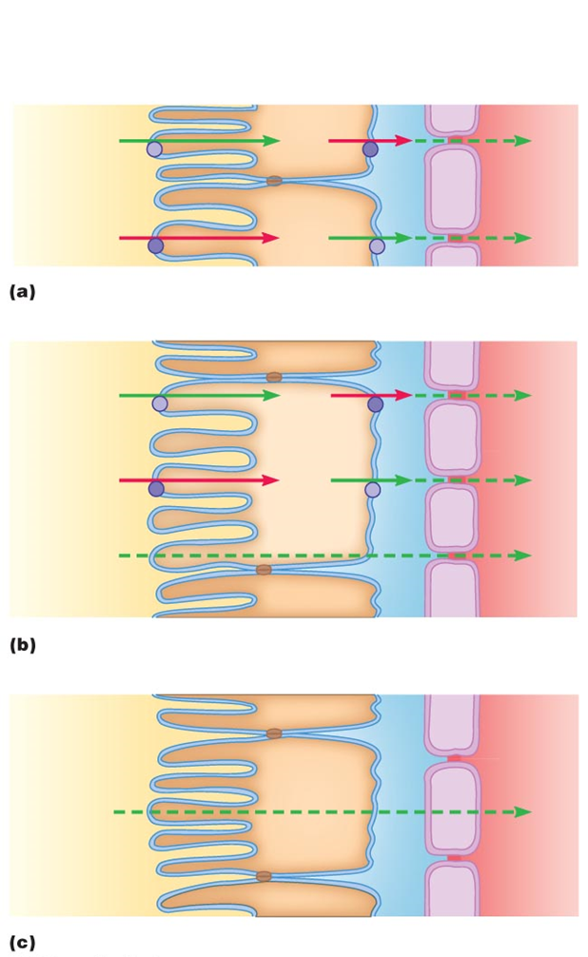

Slide 53
Transport Maximum
Rate of transport when carriers are saturated
When solute is transported across epithelium by carrier proteins, saturation of carriers can occur
Renal threshold: for a solute that is normally 100% reabsorbed
If solute in filtrate saturates carriers, then some solute is excreted in urine
Solute in plasma that causes solute in filtrate to saturate carriers and spill over into urine = renal threshold

Slide 54
Transport Maximum
Example: glucose reabsorption
Freely filtered at glomerulus
Normally 100% actively reabsorbed in proximal tubules
Normally no glucose appears in urine
Carrier proteins for glucose reabsorption
Apical membrane: secondary active transport
Basolateral membrane: facilitated diffusion

Slide 55
Transport Maximum
Renal handling of glucose
Plasma [glucose] = 100 mg/dL
Filtered load glucose = 125 mg/min
Transport maximum for glucose reabsorption = 375 mg/min
Theoretical renal threshold = 300 mg/dL
GFR × renal threshold = transport maximum
Actual renal threshold = 160–180 mg/dL
Filtered load = 225 mg/min

Slide 56
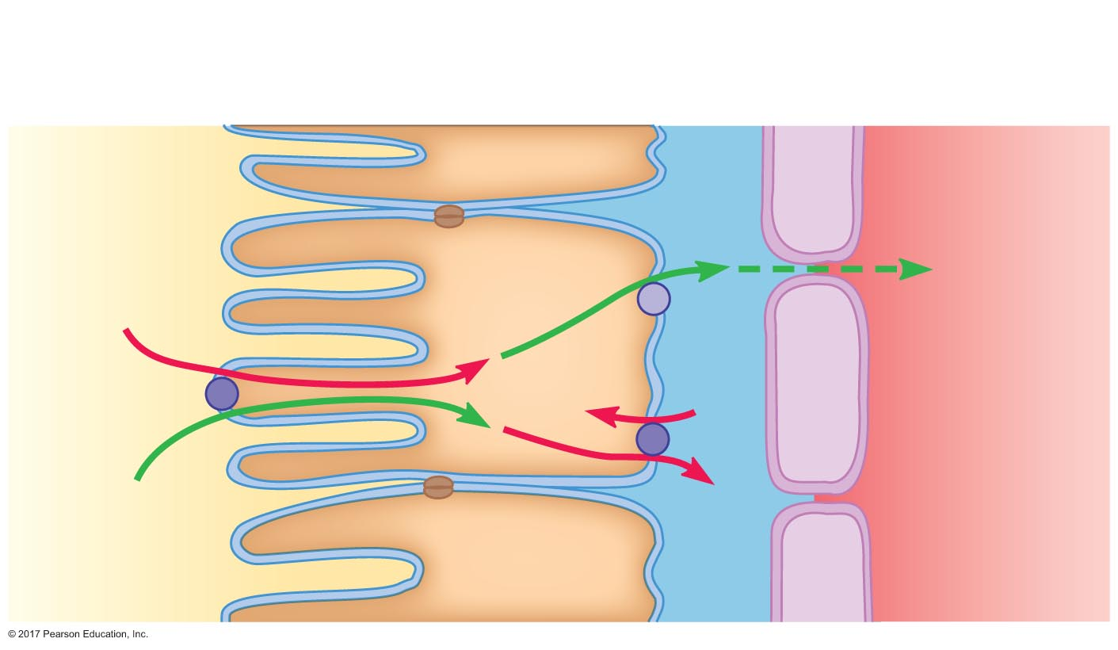
Figure 18.15 Mechanism of glucose reabsorption.
Apical
membrane
Tubule
epithelial cell
Basolateral
membrane
Capillary
endothelial cell
Glucose
Glucose
K⁺
Na⁺
Na⁺
Tubular ﬂuid
Plasma

Slide 57
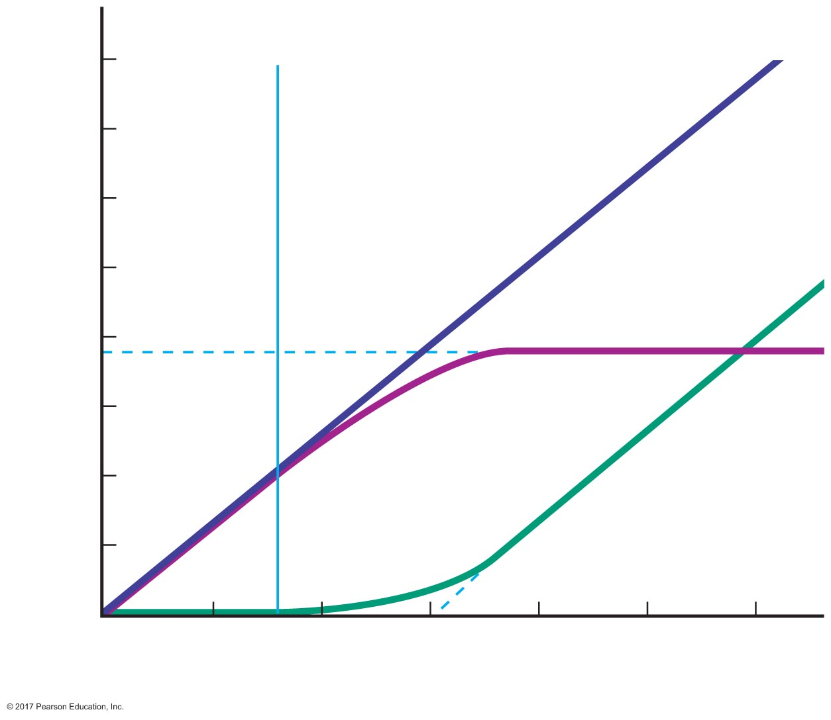
Figure 18.16 Glucose filtration, reabsorption, and excretion as a function of plasma glucose concentration.
Renal
threshold
800
700
Filtration
600
500
Reabsorption
Rate of glucose movement (mg/min)
400
Transport
maximum
300
200
Excretion
100
0
100
200
300
400
500
600
Plasma concentration of glucose (mg/dL)

Slide 58
Secretion
Solute moves from peritubular capillaries into tubules
Barriers are the same as for reabsorption
Transport mechanisms are the same, but in the opposite direction
Secreted substances
Potassium
Hydrogen ions
Choline
Creatinine
Penicillin

Slide 59
18.4 Regional Specialization of the Renal Tubules
Nonregulated reabsorption in the proximal tubules
Regulated reabsorption and secretion in the distal tubules and collecting ducts
Water conservation in the loop of Henle

Slide 60
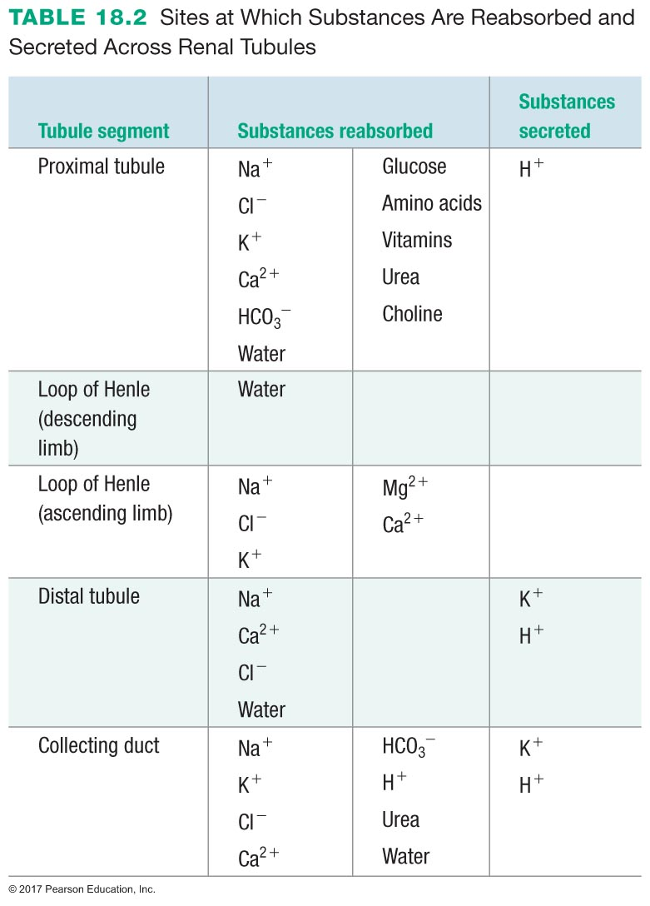

Slide 61
Nonregulated Reabsorption in the Proximal Tubules
Proximal tubule is the mass reabsorber
70% sodium and water
100% glucose
Brush border provides for large surface area
Leaky tight junctions allow paracellular transport

Slide 62
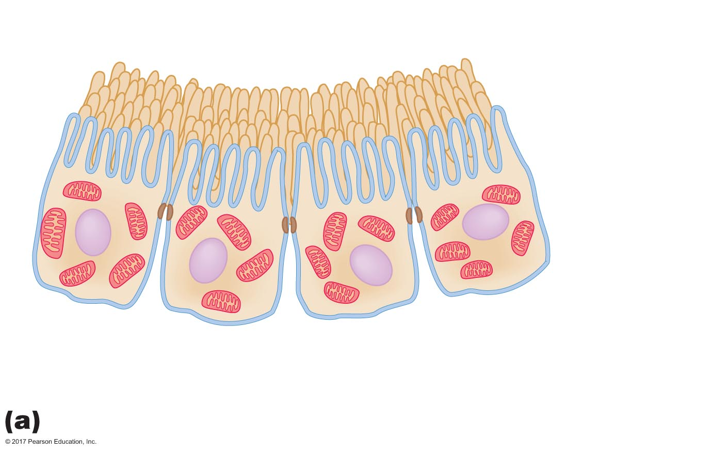
Figure 18.17a Epithelial cells in selected portions of a renal tubule.
Apical
membrane
"Leaky"
tight junction
Brush
border
Microvilli
Mitochondria
Basolateral
membrane
Proximal tubule epithelium

Slide 63
Regulated Reabsorption and Secretion in the Distal Tubules and Collecting Ducts
Transport is regulated across epithelium
Tight junctions limit paracellular transport

Slide 64
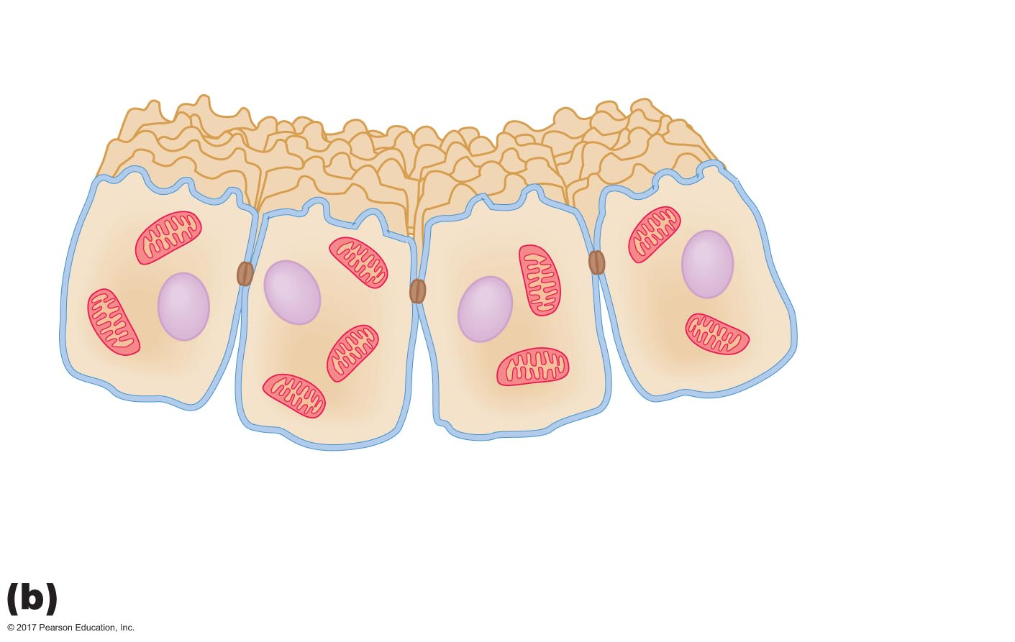
Figure 18.17b Epithelial cells in selected portions of a renal tubule.
Apical
membrane
"Tight"
tight junction
Mitochondria
Basolateral
membrane
Distal tubule and collecting duct epithelium

Slide 65
Water Conservation in the Loop of Henle
Loop of Henle establishes conditions necessary to concentrate urine
Minimizes water loss

Slide 66
18.5 Excretion
Excretion rate
Clearance
Micturition

Slide 67
Excretion Rate
Amount of substance excreted = amount filtered + amount secreted – amount reabsorbed
Amount excreted depends on three factors:
Filtered load
Secretion rate
Reabsorption rate
If amount of solute excreted per minute is less than filtered load → solute was reabsorbed
If amount of solute excreted per minute is greater than filtered load → solute was secreted

Slide 68
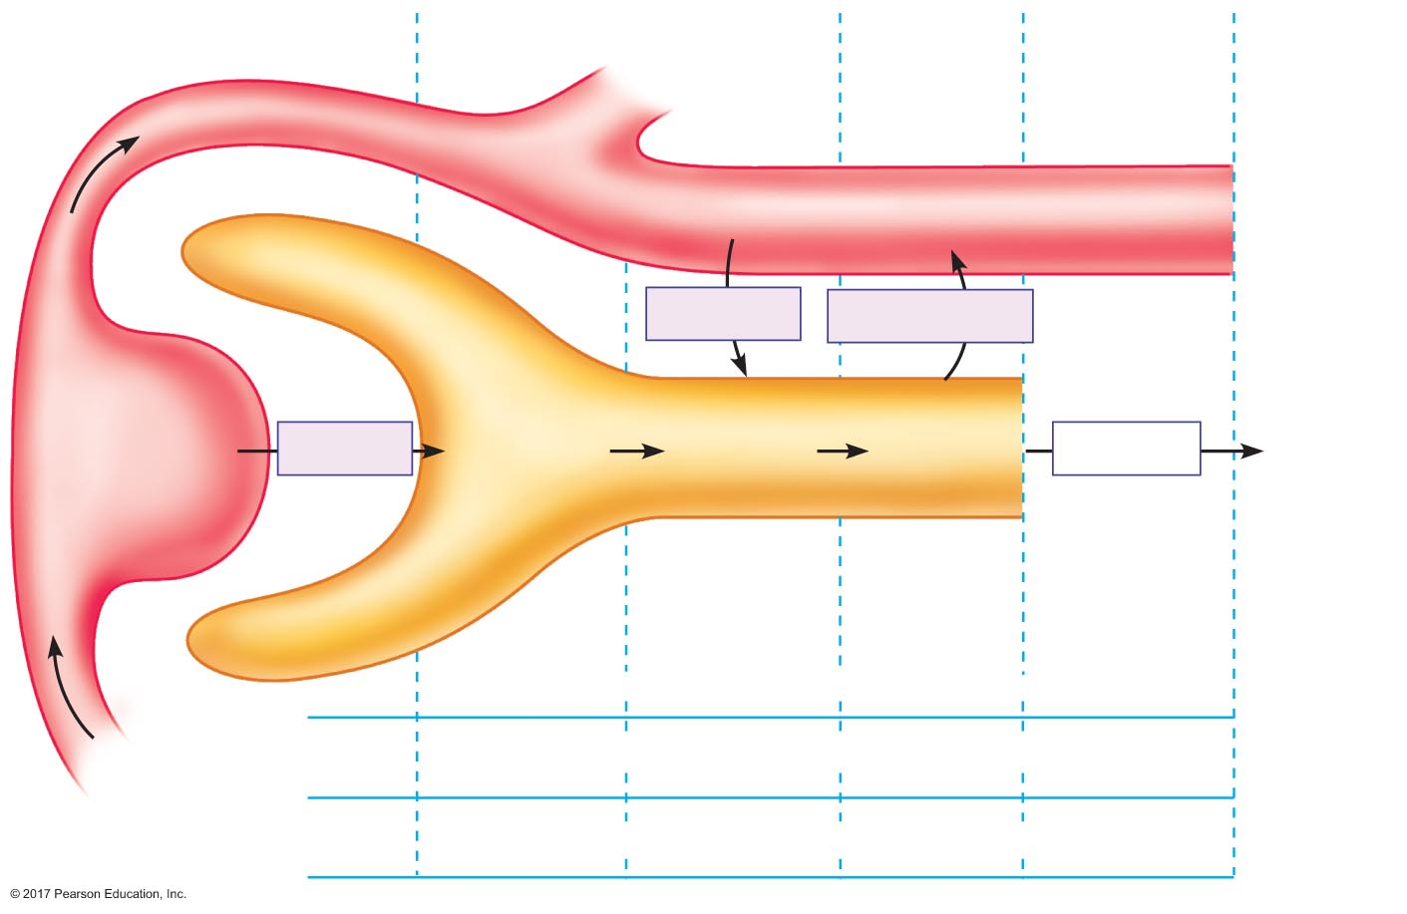
Figure 18.18 Schematic representation of the four basic renal processes.
Efferent
arteriole
Peritubular
capillary
3 mmole
solute
6 mmole solute
Bowman's
capsule
145 mL H₂O
Glomerulus
Secretion
Reabsorption
Renal tubule
P_{solute} =
0.08 mmole/mL
12 mmole
solute
15 mmole
solute
9 mmole
solute
9 mmole
solute
Filtration
Excretion
150 mL H₂O
150 mL H₂O
5 mL H₂O
5 mL H₂O
Amount
ﬁltered
Amount
secreted
Amount
reabsorbed
Amount
excreted
+
–
=
Solute
12 mmole
+
3 mmole
–
6 mmole
=
9 mmole
Afferent
arteriole
Water
150 mL
+
0 mL
–
145 mL
=
5 mL

Slide 69
Clearance
Volume of plasma from which a substance has been removed by kidneys per unit time (volume of plasma that contains the amount of a substance that has been excreted per unit time)
excretion rate U_{x} × V
Clearance = =
plasma concentration P_{x}

Slide 70
Clearance
Clearance of inulin
Clearance of substance freely filtered and neither reabsorbed nor secreted = GFR
Amount of inulin excreted in urine = amount that was filtered = filtered load
Excretion rate = filtered load = GFR × P_{i}
excretion rate GFR × P_{i}
Clearance_{i} = = = GFR
plasma concentration P_{i}

Slide 71
Clearance
Inulin clearance
(U_{inulin})(V)
C_{inulin} = =
P_{inulin}
(250 mmole/L) (2.0 mL/min)
C_{inulin} = = 125 mL/min
(4 mmole/L)

Slide 72
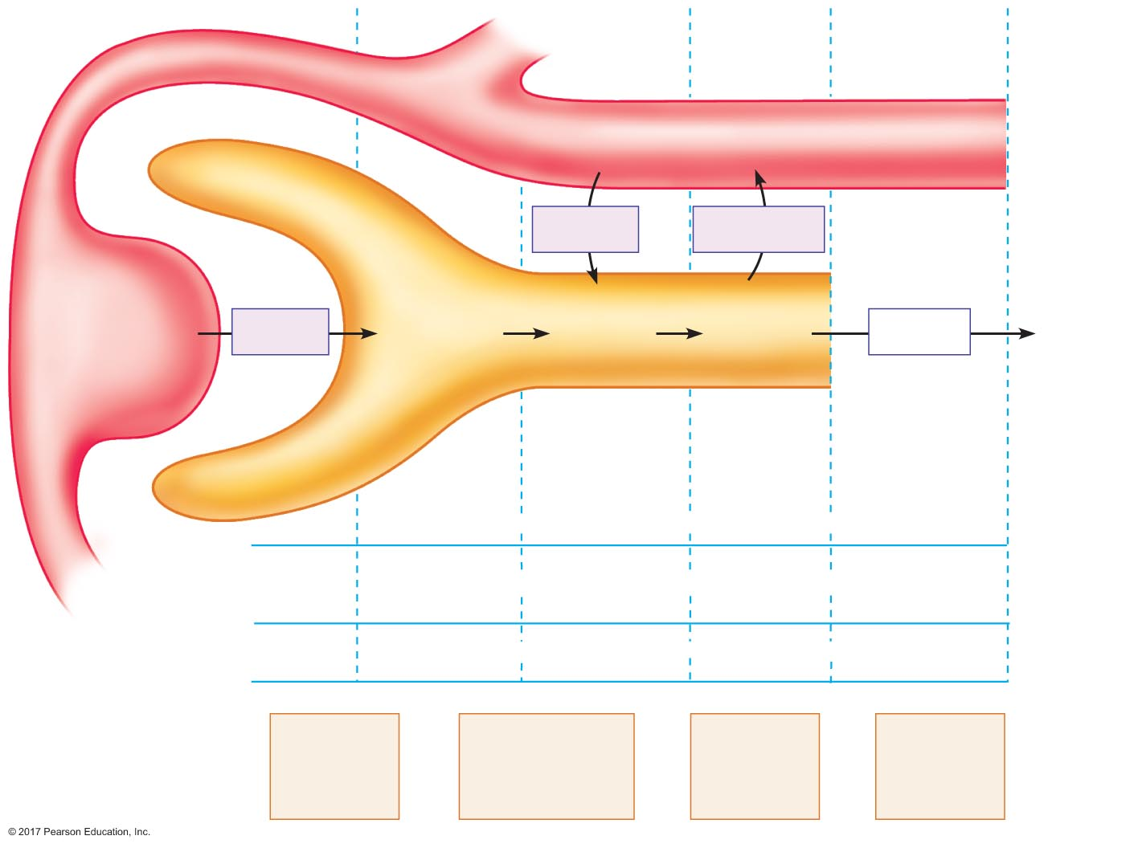
Figure 18.19 Clearance of inulin.
0 mmole
inulin
123 mL H₂O
Secretion
Reabsorption
0.5 mmole
inulin
0.5 mmole
inulin
0.5 mmole
inulin
0.5 mmole
inulin
P_{inulin} = 4 mmole/L
Filtration
Excretion
125 mL H₂O
125 mL H₂O
2 mL H₂O
2 mL H₂O
Amount
ﬁltered
+
Amount
secreted
–
Amount
reabsorbed
=
Amount
excreted
Solute
0.5 mmole
inulin
+
0 mmole
inulin
–
0 mmole
inulin
=
0.5 mmole
inulin
Water
125 mL
+
0 mL
–
123 mL
=
2 mL
Clearance
of
inulin
Volume of plasma
that contained the
amount of inulin
excreted
Volume
of plasma
ﬁltered
=
=
=
GFR

Slide 73
Clearance
Use of creatinine to estimate GFR
Creatinine: by-product of muscle metabolism
Produced in body
Freely filtered
Not reabsorbed
Small amount secreted
Clearance: "estimate" of GFR
Clearance is a little greater than GFR: 140 mL/min

Slide 74
Clearance
Clearance of glucose
Clearance of substance completely reabsorbed = 0
U_{g} x V (0 mmole/L) × V
Clearance_{g} = = = 0 mL/min
P_{g} P_{g}

Slide 75
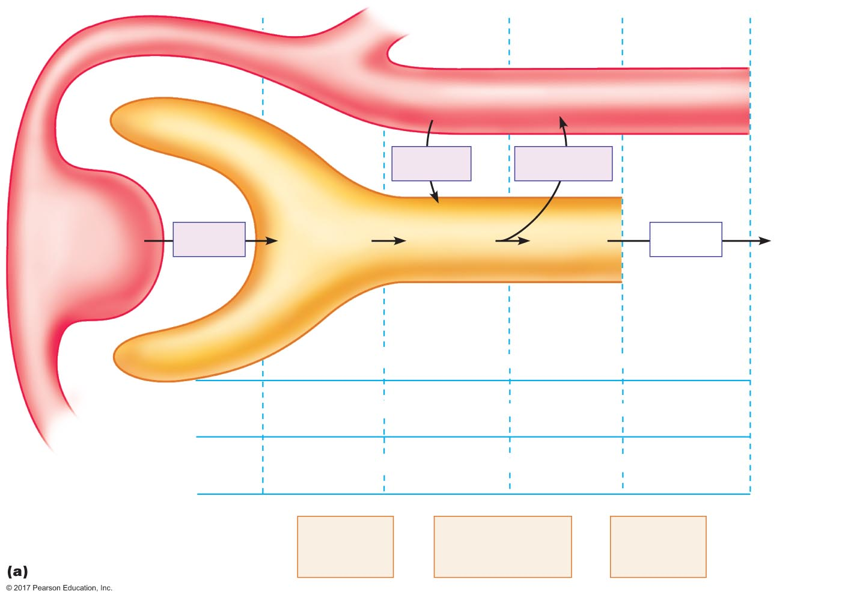
Figure 18.20a Examples of clearance.
Slide 1
0 mg glucose
125 mg glucose
123 mL H₂O
Secretion
Reabsorption
125 mg
glucose
125 mg
glucose
0 mg
glucose
0 mg
glucose
P_{glucose} =
Filtration
Excretion
1 mg/mL
125 mL
H₂O
125 mL
H₂O
2 mL
H₂O
2 mL H₂O
Amount
ﬁltered
+
Amount
secreted
–
Amount
reabsorbed
=
Amount
excreted
Solute
125 mg
glucose
+
0 mg
glucose
–
125 mg
glucose
=
0 mg
glucose
Water
125 mL
H₂O
+
0 mL
H₂O
–
123 mL
H₂O
=
2 mL
H₂O
Clearance
of
glucose
Volume of plasma
that contained
0 mg glucose/min
=
=
0 mL/min
Clearance of glucose

Slide 76
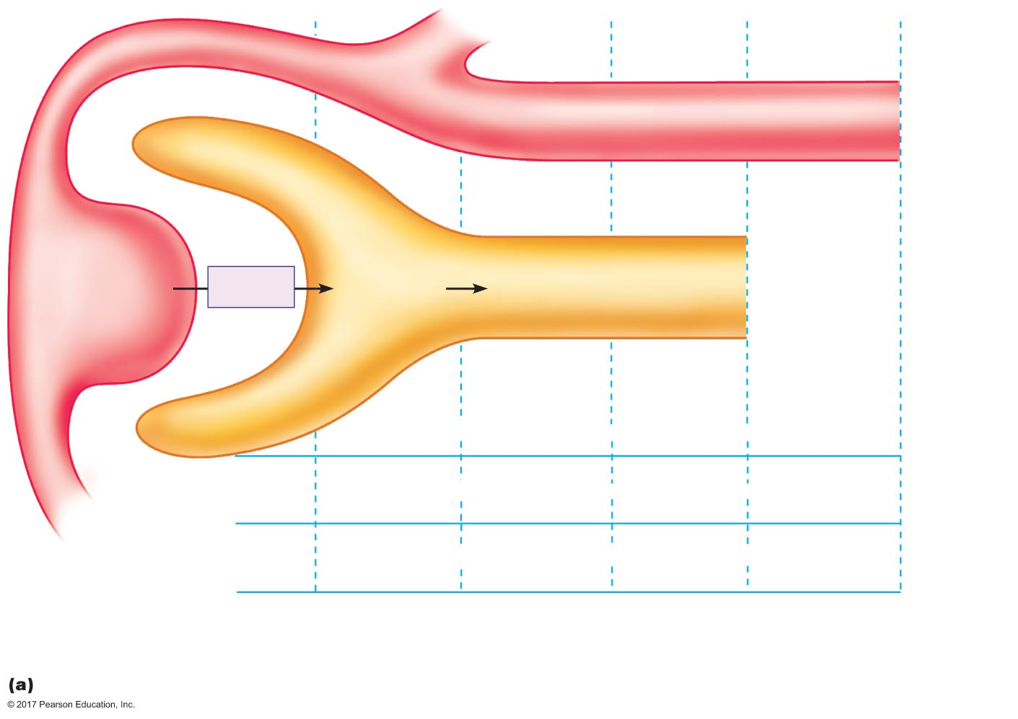
Figure 18.20a Examples of clearance.
Slide 2
125 mg
glucose
P_{glucose} =
Filtration
1 mg/mL
125 mL
H₂O
Amount
ﬁltered
+
Solute
125 mg
glucose
+
Water
125 mL
H₂O
+
Clearance of glucose

Slide 77

Figure 18.20a Examples of clearance.
Slide 3
0 mg glucose
Secretion
125 mg
glucose
125 mg
glucose
P_{glucose} =
Filtration
1 mg/mL
125 mL
H₂O
125 mL
H₂O
Amount
ﬁltered
+
Amount
secreted
–
Solute
125 mg
glucose
+
0 mg
glucose
–
Water
125 mL
H₂O
+
0 mL
H₂O
–
Clearance of glucose

Slide 78

Figure 18.20a Examples of clearance.
Slide 4
0 mg glucose
125 mg glucose
123 mL H₂O
Secretion
Reabsorption
125 mg
glucose
125 mg
glucose
0 mg
glucose
P_{glucose} =
Filtration
1 mg/mL
125 mL
H₂O
125 mL
H₂O
2 mL
H₂O
Amount
ﬁltered
+
Amount
secreted
–
Amount
reabsorbed
=
Solute
125 mg
glucose
+
0 mg
glucose
–
125 mg
glucose
=
Water
125 mL
H₂O
+
0 mL
H₂O
–
123 mL
H₂O
=
Clearance of glucose

Slide 79
Figure 18.20a Examples of clearance.
Slide 5
0 mg glucose
125 mg glucose
123 mL H₂O
Secretion
Reabsorption
125 mg
glucose
125 mg
glucose
0 mg
glucose
0 mg
glucose
P_{glucose} =
Filtration
Excretion
1 mg/mL
125 mL
H₂O
125 mL
H₂O
2 mL
H₂O
2 mL H₂O
Amount
ﬁltered
+
Amount
secreted
–
Amount
reabsorbed
=
Amount
excreted
Solute
125 mg
glucose
+
0 mg
glucose
–
125 mg
glucose
=
0 mg
glucose
Water
125 mL
H₂O
+
0 mL
H₂O
–
123 mL
H₂O
=
2 mL
H₂O
Clearance
of
glucose
Volume of plasma
that contained
0 mg glucose/min
=
=
0 mL/min
Clearance of glucose

Slide 80
Clearance
Clearance of PAH
Clearance of substance freely filtered, fully secreted, and not reabsorbed = renal plasma flow rate
Amount excreted = amount contained in volume of plasma that entered the kidneys

Slide 81
Clearance
Renal blood flow
PAH clearance = measure of renal plasma flow
Converts plasma flow to blood flow
Blood is 55% plasma
clearance PAH 625 mL/min
Renal blood flow = = = 1136 mL/min
1 – hematocrit 0.55

Slide 82

Figure 18.20b Examples of clearance.
2.0 mmole
PAH
123 mL H₂O
Secretion
Reabsorption
0.5 mmole
PAH
2.5 mmole
PAH
2.5 mmole
PAH
2.5 mmole
PAH
P_{PAH} =
Filtration
Excretion
4 mmole/mL
125 mL
H₂O
125 mL
H₂O
2 mL
H₂O
2 mL H₂O
Amount
ﬁltered
+
Amount
secreted
–
Amount
reabsorbed
=
Amount
excreted
Solute
0.5 mmole
PAH
+
2.0 mmole
PAH
–
0 mmole
PAH
=
2.5 mmole
PAH
Water
125 mL
H₂O
+
0 mL
H₂O
–
123 mL
H₂O
=
2 mL
H₂O
Clearance
of
PAH
Volume of plasma
that contained
2.5 mmole PAH
2.5 mmole PAH/min
4 mmole PAH/1000 mL H₂O
=
=
=
625 mL/min
Clearance of PAH

Slide 83
Clearance
Determining the fate of solutes in renal tubules
If C_{x} > GFR, then substance was secreted
If C_{x} < GFR, then substance was reabsorbed

Slide 84
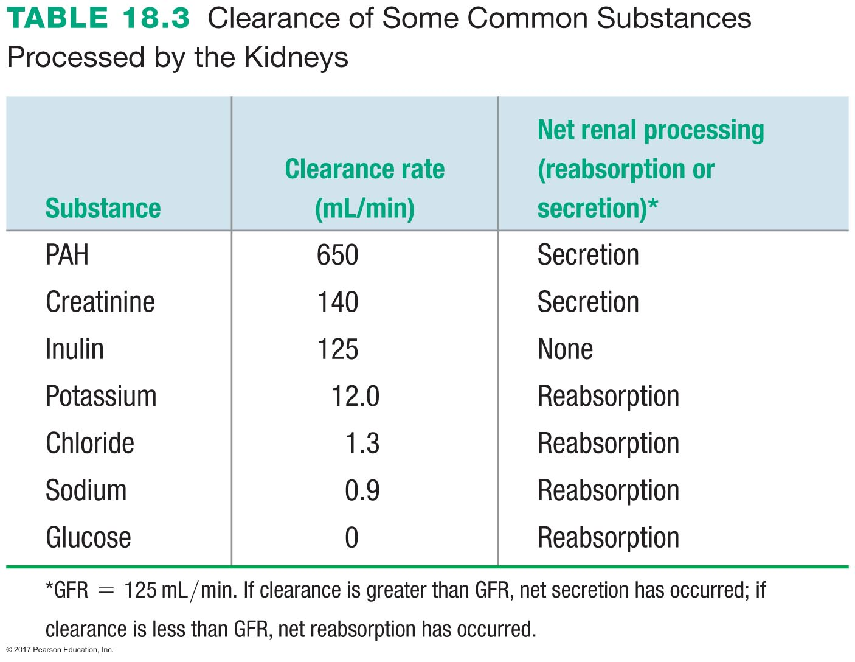

Slide 85
Micturition
Micturition = urination
Urine formed in renal tubules
Fluid drains into renal pelvis and into ureter
Ureters lead to bladder
Bladder stores urine until it is excreted

Slide 86
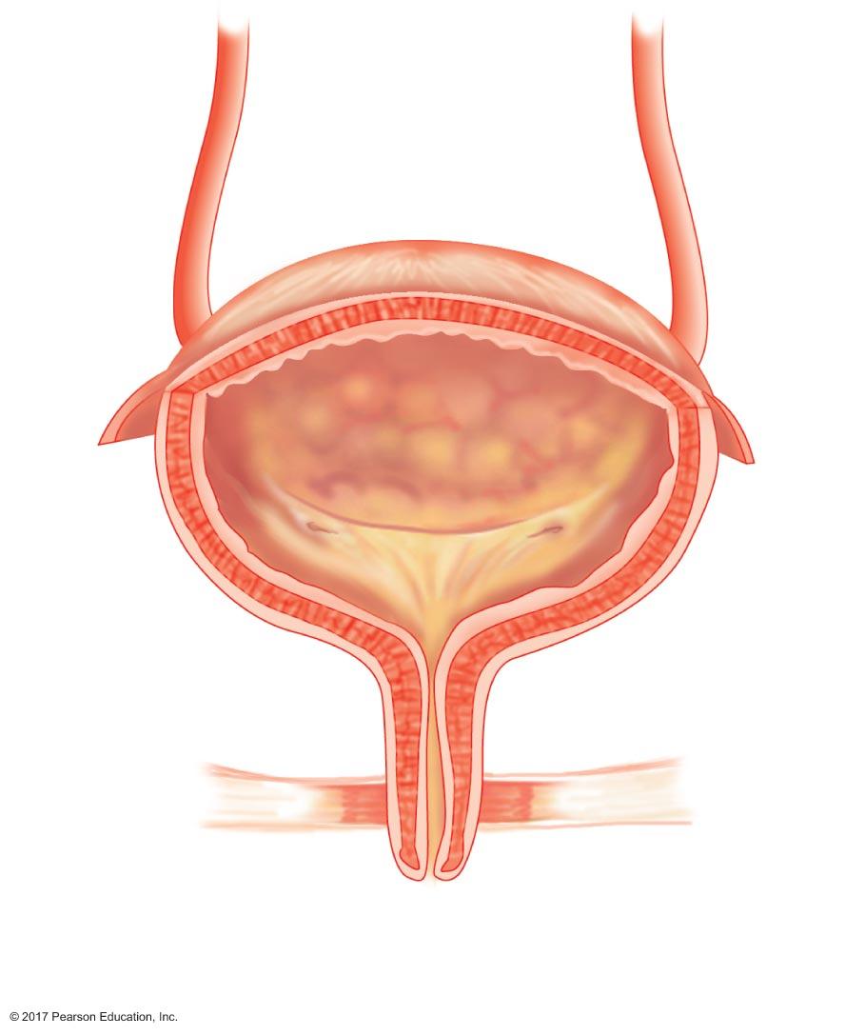
Figure 18.21 Anatomy of the urinary bladder and urethra.
Ureters
Detrusor
muscle
Bladder
neck
Internal
urethral
sphincter
Urethra
Pelvic ﬂoor
External
urethral
sphincter
External
urethral
oriﬁce

Slide 87
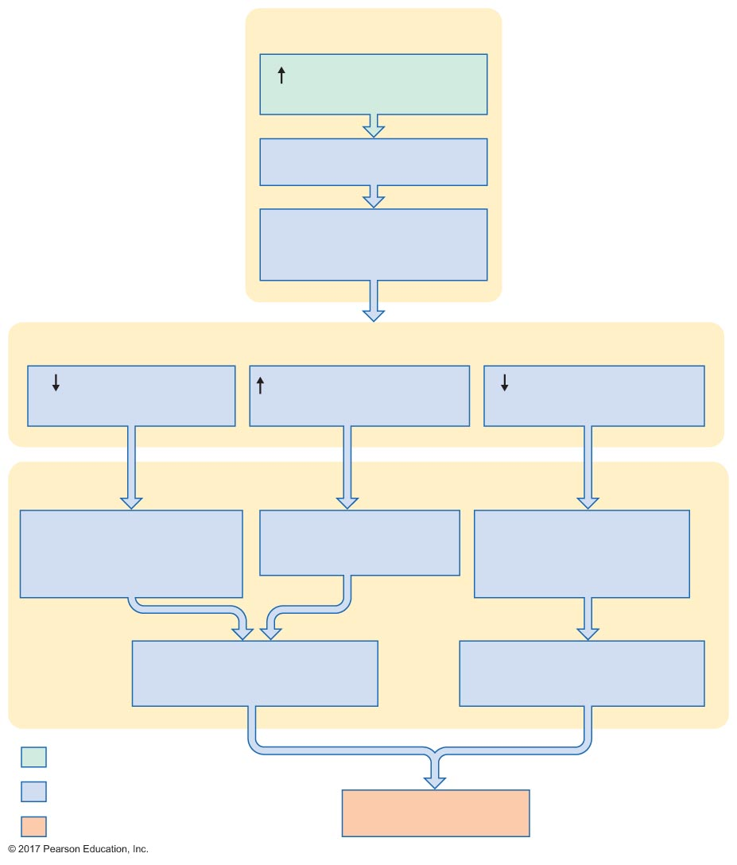
Figure 18.22 Elements of the micturition reflex.
Slide 1
Bladder
Volume of ﬂuid
in bladder
Expansion of wall
Activation of
stretch receptors
Spinal cord
Sympathetic
activity
Parasympathetic
activity
Somatic motor
neuron activity
Bladder
Relaxation of
internal urethral
sphincter
Contraction of
detrusor muscle
Relaxation of
external urethral
sphincter
Opening of internal
urethral sphincter
Opening of external
urethral sphincter
Initial stimulus
Physiological response
Result
Micturition

Slide 88
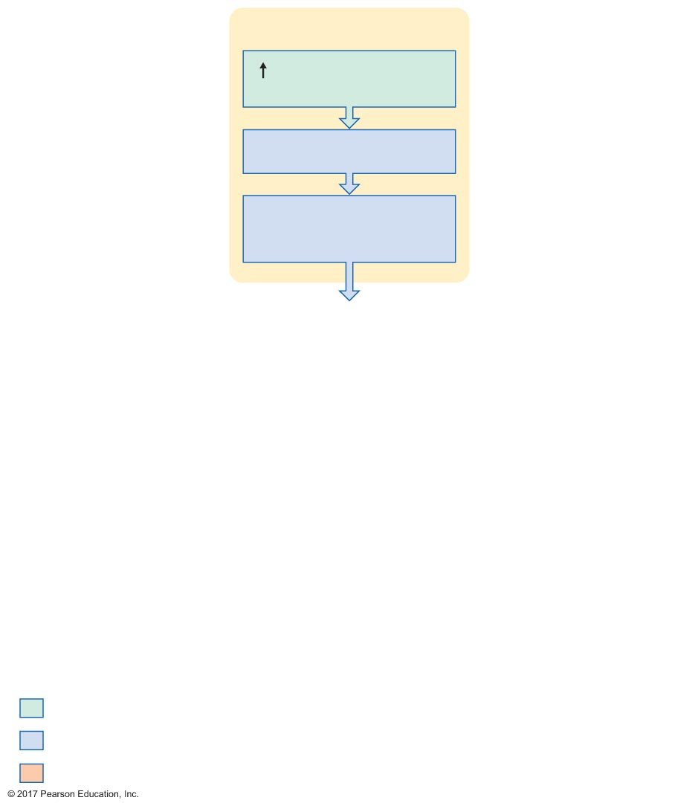
Figure 18.22 Elements of the micturition reflex.
Slide 2
Bladder
Volume of ﬂuid
in bladder
Expansion of wall
Activation of
stretch receptors
Initial stimulus
Physiological response
Result

Slide 89
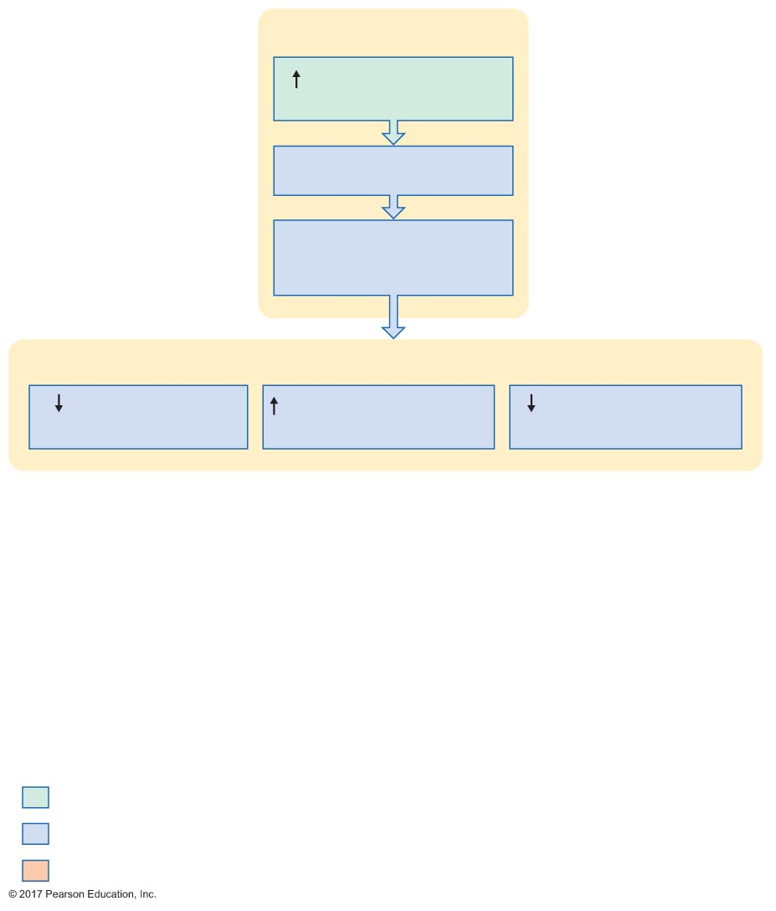
Figure 18.22 Elements of the micturition reflex.
Slide 3
Bladder
Volume of ﬂuid
in bladder
Expansion of wall
Activation of
stretch receptors
Spinal cord
Sympathetic
activity
Parasympathetic
activity
Somatic motor
neuron activity
Initial stimulus
Physiological response
Result

Slide 90
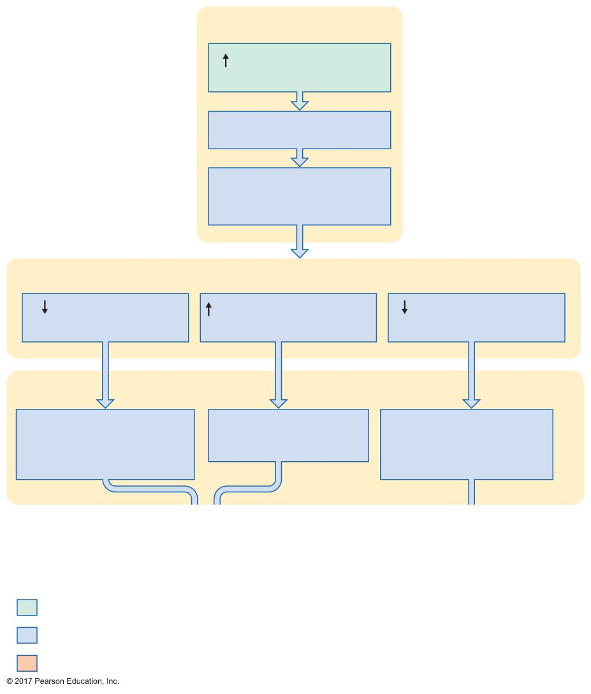
Figure 18.22 Elements of the micturition reflex.
Slide 4
Bladder
Volume of ﬂuid
in bladder
Expansion of wall
Activation of
stretch receptors
Spinal cord
Sympathetic
activity
Parasympathetic
activity
Somatic motor
neuron activity
Bladder
Relaxation of
internal urethral
sphincter
Contraction of
detrusor muscle
Relaxation of
external urethral
sphincter
Initial stimulus
Physiological response
Result

Slide 91
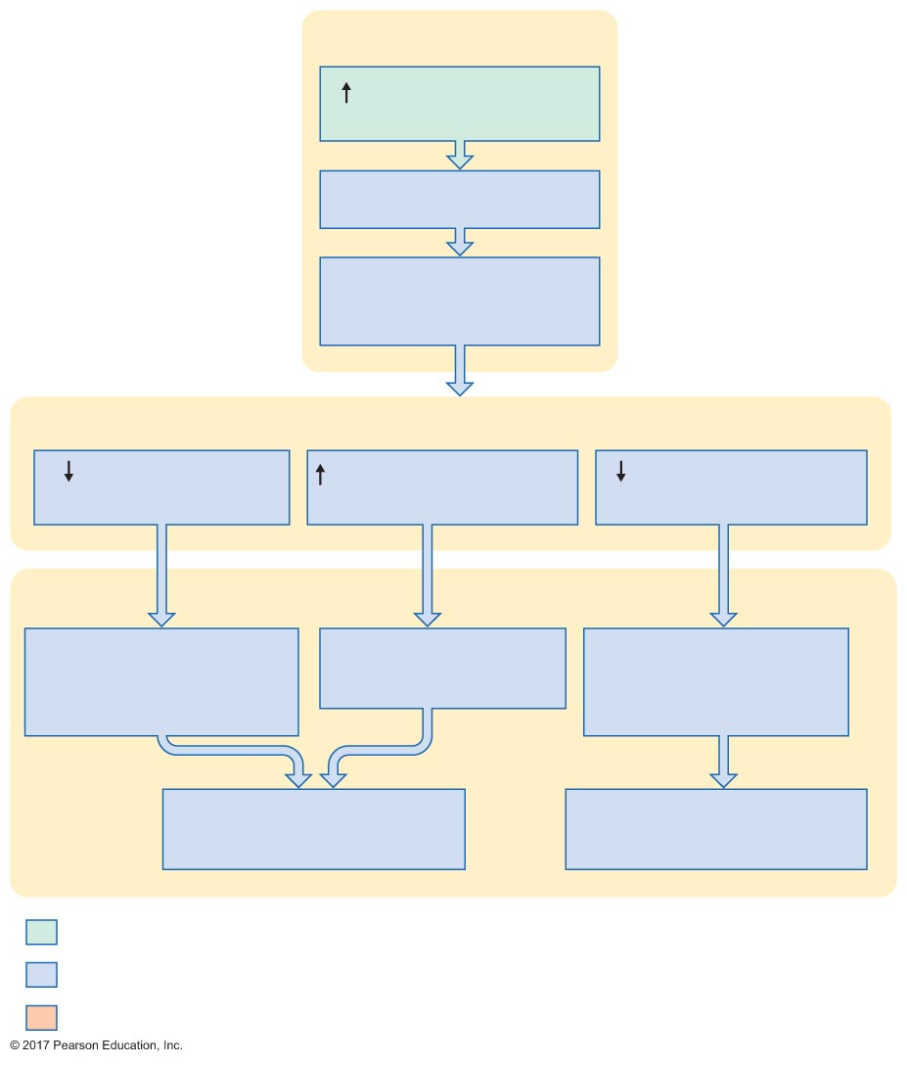
Figure 18.22 Elements of the micturition reflex.
Slide 5
Bladder
Volume of ﬂuid
in bladder
Expansion of wall
Activation of
stretch receptors
Spinal cord
Sympathetic
activity
Parasympathetic
activity
Somatic motor
neuron activity
Bladder
Relaxation of
internal urethral
sphincter
Contraction of
detrusor muscle
Relaxation of
external urethral
sphincter
Opening of internal
urethral sphincter
Opening of external
urethral sphincter
Initial stimulus
Physiological response
Result

Slide 92
Figure 18.22 Elements of the micturition reflex.
Slide 6
Bladder
Volume of ﬂuid
in bladder
Expansion of wall
Activation of
stretch receptors
Spinal cord
Sympathetic
activity
Parasympathetic
activity
Somatic motor
neuron activity
Bladder
Relaxation of
internal urethral
sphincter
Contraction of
detrusor muscle
Relaxation of
external urethral
sphincter
Opening of internal
urethral sphincter
Opening of external
urethral sphincter
Initial stimulus
Physiological response
Result
Micturition

